Slide 1
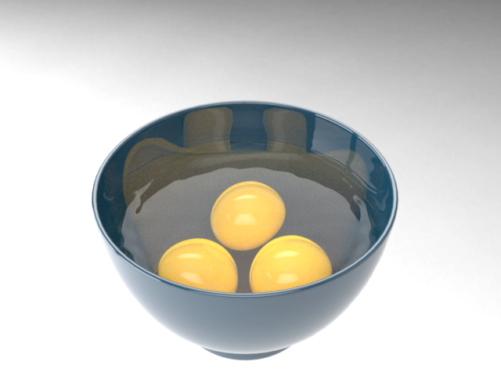
Mixing Eggs

