Slide 1
Pedestrian Reasoning using geometric reasoning in velocity space
Sean Curtis and Dinesh Manocha
PED 2012
June 8, 2012

Slide 2
Pedestrian Simulation
Ideal Simulator Properties
Utility
Stability – Size of the largest viable time step
Efficiency – Cost of a single time step
Behavior
Credibility
Robust
Parameters constant w.r.t. environment.
Only vary for population.
Behavior most important
Getting the wrong answer quickly avails nothing.
= stability / efficiency
Notes:
I’d like to briefly discuss the properties of the ideal pedestrian simulator
The first property is utility. The pedestrian needs to be practical. To make an extreme example, if a simulator requires days to simulate a relatively simple scenario, it would be impractical to use it for complex scenarios.
Utility arises from two other properties: stability and efficiency
The simulator’s stability is related to the largest time step you can take and still get viable results.
The simulator’s efficiency is the actual computation cost of a single time step.
The full utility depends on both. Maximizing utility is a balance of both of these properties.
For example, implicit integration increases the cost of a single time step, but allows for a significantly larger time step. The net result may be a gain in utility. Ultimately, we endeavor to maximize the utility of our simulators.
The second important property of an ideal simulator is the behavior. Fundamentally, we want the simulator to produce accurate, meaningful behavior.
This property implies the credibility of the simulator. Can we rely on the predictions a simulator makes. Of course, this is not a binary state. Fully reliable or wholly unreliable. There may be aspects of the simulator sufficiently reliable to produce credible results in certain scenarios, but not others.
Of these two properties, behavior is the most important. If the results are suspect, it doesn’t matter how quickly we derived them.

Slide 3
Previous Work
Social forces
Newtonian-like forces applied to mass particles.
Research focuses on force formulation
Redefine basic repulsion forces.
Introduce new forces to produce novel behaviors.
[Helbing & Molnar 1995; Helbing et al. 2000; Yu et al. 2005; Chraibi et al. 2010; Moussaïd et al. 2010]
Notes:
The pedestrian dynamics community has largely considered two major classes of pedestrian models.
The first is social forces. Social force models treat pedestrians as mass-particles and model pedestrian behavior and interactions as a superpositioning of forces. Most of the work in this domain are focused on formulations of the forces, including customized forces to introduce novel behaviors.

Slide 4
Previous Work
Cellular Automata
Discretization of pedestrian space into uniform cells.
Agents occupy cells and move from cell to cell according to rules.
Research on movement rules and nature of the grid.
[Blue & Adler 1998; Burstedde et al. 2001; Kirchner et al. 2004; Maniccam 2003; Yamamoto et al. 2007]
Notes:
Cellular automata is the second class of common pedestrian models. It operates on a discretization of the simulation domain. Typically, agents occupy a single cell and a cell can hold, at most, a single agent. The agents move from cell to cell based on a set of rules.
The earliest work used hand-crafted rules for pedestrian movement. Later work introduced probabilitic models to govern the movement. Research in this domain has consistent of examining the domain (including higher-tesselations in which agents can occupy and move multiple cells per time step, alternative rule formulations, and even alternative tesselations (such as hexagonal tesselation.)

Slide 5
Previous Work
Velocity Obstacles
Use optimization techniques, in velocity space, to find a collision-free velocity.
Optimize with respect to a “velocity obstacle”.
Varies in definition of obstacle and optimization method.
[Fiorini & Schiller 1998; van den Berg 2008; van den Berg et al. 2009; Guy et al. 2012]
Notes:
Our work is based on a model used in robotics called “velocity obstacles”.
Simply put, these techniques perform optimization techniques in velocity space to directly compute a collision-free velocity. It uses the concept of the “velocity obstacle” to perform this computation. I’ll go a bit more detail into this later. Most of the research in these techniques vary how the velocity obstacle is defined and what optimization functions are used.

Slide 6
Velocity Obstacle
Intuition
Uses position and velocity to anticipate collisions.
Response
Required
NO Response
Required
Response
Required
Notes:
Intuitively, velocity obstacles automatically account for position and velocity in devising a response. It uses velocity to make predictions over a small window to determine if a response is necessary. In these three cases, it correctly identifies whether the other agent represents an imminent collision.
First, this stationary agent sits on the red agent’s intended path. A response is required. This would be detected considering only position.
Second, the agent, which currently lies on the path, is moving perpendicularly. It will no longer be on the path when the red agent arrives, no response is required. Considering only position will falsely require a response.
Finally, the agent is not currently on the path, but will be. A response is required. Such a response would not necessarily be taken when considering only position.

Slide 7
Velocity Obstacle
A set of velocities which will lead to an inevitable collision.
Notes:
I’d like to provide a simple overview of velocity obstacles, and the particular variation we use, called ORCA.
The central idea of the this approach is the velocity obstacle. It is a set of velocities, which, if taken, will lead to an inevitable collision. Let’s look at an example.
Here we have an agent and an obstacle. We can easily determine a region of space (called the Minkowski sum). If the agent’s center is anywhere within this region, it is colliding with the obstacle.
From this we can draw a cone originating from the agent and bounding this collision region. We know that any velocity inside of this cone will lead to an eventual collision.
However, in practice, we aren’t worried about collisions that happen hours from now. So, we can account for that by truncating the cone in this manner. Now, this shorter velocity is viable because it won’t lead to a collision within some specified time range. Finally, we simply select a velocity outside of the velocity obstacle to avoid collision.

Slide 8
Velocity Obstacle
Navigate by selecting “best” velocity outside of the obstacle.
Notes:
We use this to navigate by providing a preferred velocity. If the preferred velocity already lies outside the velocity obstacle, it is viable and the agent can take it.
If the preferred velocity lies within the velocity obstacle, we select the velocity outside the obstacle which “best” approximates the preferred velocity.

Slide 9
Velocity Obstacle
Velocity obstacle for moving objects is translated by that object’s velocity.
This is the original VO formulation [Fiorini & Schiller 1998].
Notes:
What we just saw is how the agent responds to a static obstacle. But what if it is moving? Like another agent? We simply translate the velocity obstacle by that velocity.

Slide 10
Velocity Obstacle
Predicting responsive obstacles
Notes:
More particularly, the agent isn’t optimizing with respect to what the dynamic obstacle is going to do. It is planning with respect to what it THINKS the obstacle is going to do. If the prediction is wrong, the agent is optimizing with respect to the wrong velocity obstacle and an apparently collision-free velocity is no longer collision-free. The previous example showed an un-responsive moving obstacle. But what if the obstacle responds to the agent?
Here we have the agen’ts preferred velocity. It predicts that the obstacle will move with this velocity. The corresponding velocity obstacle would be look like this. The agen’ts preferred velocity isn’t viable and it selects a suitable alternative. However, it turns out that the agent is actually moving with THIS velocity inducing THIS velocity obstacle. It turns out, the selected velocity is not viable, and the original, preferred velocity is viable. This naturally leads to simulation stability issues.

Slide 11
Optimal Reciprocal Collision Avoidance (ORCA)
[van den Berg et al. 2009]
Notes:
ORCA addresses this problem by changing the representation of the velocity obstacle. Instead of a single truncated cone, it models the velocity obstacle as a half-plane. You can think of it as the union of many predictions. The agent is now predicting that the other entity is taking one of many possible velocities and avoiding all of them.
I won’t get into the exact definition of this plane here. I’d refer you to our paper for the highlights and the original paper for the details.

Slide 12
Optimal Reciprocal Collision Avoidance (ORCA)
Properties
Efficient
35,000 agents at 38 ms per time step. [Curtis et al. 2011]
Stable
Stable at time steps as large as 0.2 s. [Curtis et al. 2012]
Behavior
Self-organizing behavior (lane formation, arching, jamming, etc.) [Guy et al. 2012]

Slide 13
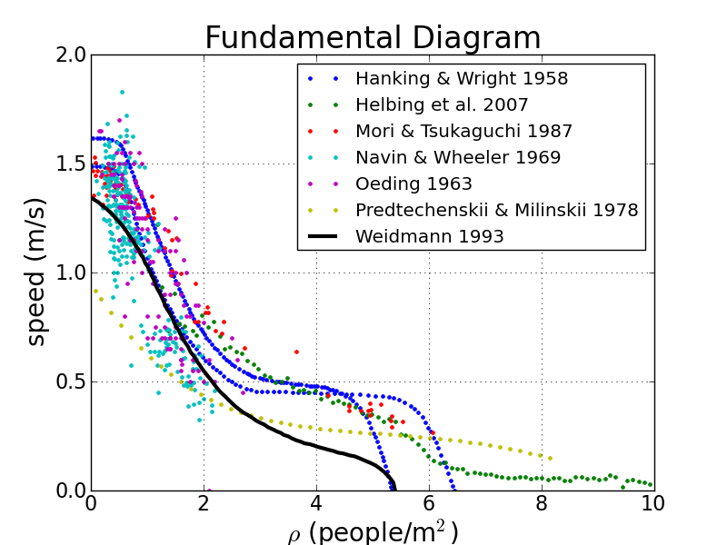
Fundamental Diagram
Universally observed property of groups of pedestrians.
As density increases, speed decreases.

Slide 14
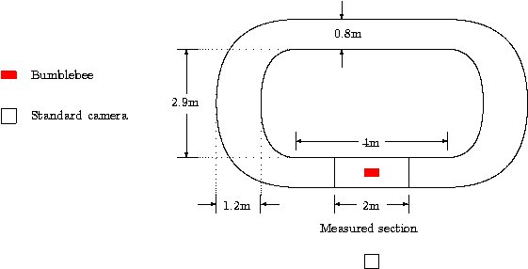
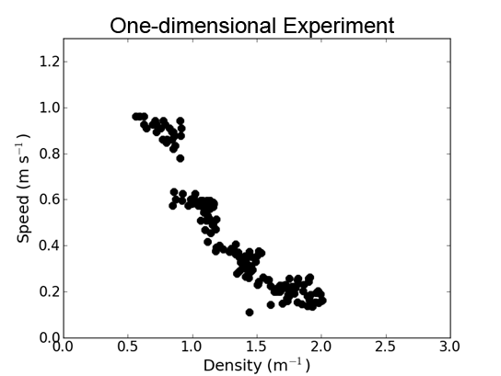
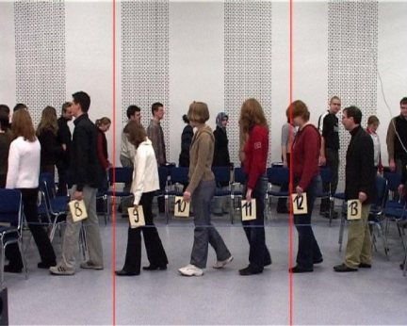
Fundamental Diagram
1D Fundamental Diagram Experiment [Seyfried et al. 2005]

Slide 15
Fundamental Diagram
Reproduced with ORCA

Slide 16
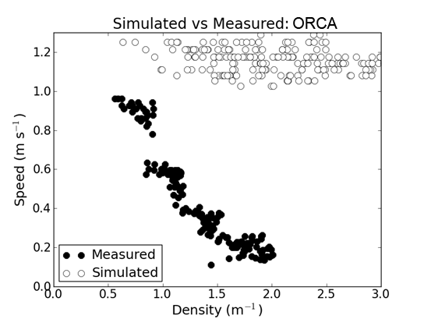
Fundamental Diagram
ORCA does not exhibit the fundamental diagram.
How do we rectify this?
Notes:
Emphasize here that I don’t simply want to use the fundamental diagram as input. Because that raises the question, WHICH fundamental diagram should I use? It varies based on simulation conditions, population parameters, etc. Instead, we seek to model some of the underlying origins of the FD.
NOTE: This is a model of a hypothesis. Parts of it are well justified by science, other aspects are speculative, but reasonable.

Slide 17
Fundamental Diagram
Origins
Physiological
Constraints on human locomotion.
Psychological
Ability to estimate safe walking speeds.
Preferences for personal space.

Slide 18
Fundamental Diagram
Physiological Origins
Relationship between walking speed and stride length. [Inman et al. 1981]
Walking speed minimizes energy per meter traveled.
For a speed, there is a “natural” energy-minimizing stride length.
Stride length grows as speed increases.*
Limited space → limited stride length → reduced speed.
* Up to a physical limit.

Slide 19
Fundamental Diagram
Physiological Origins
Stride length (L) and walking speed (v) [Dean 1965].
α – the “stride factor”.
H – a height normalizing factor.
*
* Weidmann cited [Margaria 1976] in reporting a linear relationship.
Notes:
This will be the single most controversial statement I make.

Slide 20
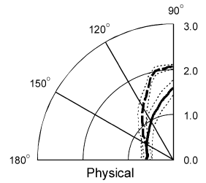
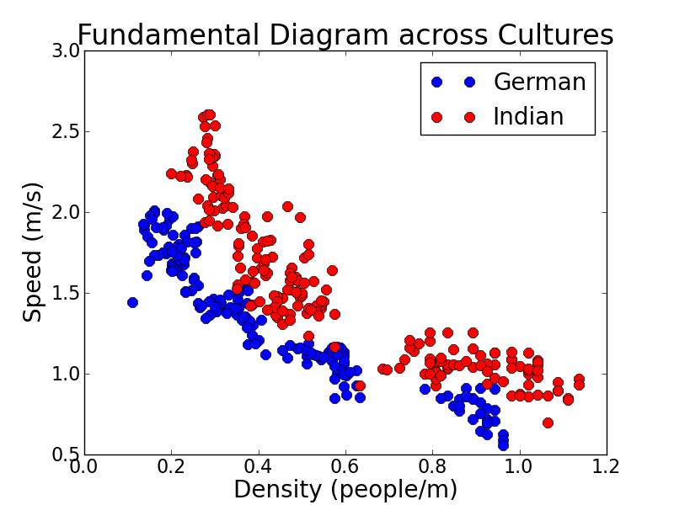
Fundamental Diagram
Psychological Origins
Personal space
A spatial buffer between a pedestrian and its environment.
Cultural variance
Repeat 1D experiment with Indians.
[Gérin-Lajoie et al. 2005]
[Chattaraj et al. 2009]
Notes:
This will be the single most controversial statement I make.

Slide 21
Fundamental Diagram
Psychological Origins
Seek to model this psychological buffer.
Simple linear model – buffer size dependent on stride length.
The parameter β is the “stride buffer” parameter.
Notes:
This will be the single most controversial statement I make.

Slide 22
Fundamental Diagram
Density-dependent Speed
Determine “natural” speed for given space in front of agent.
v⁰ – the preferred speed.
S – the space in front of the agent.
Notes:
This will be the single most controversial statement I make.

Slide 23
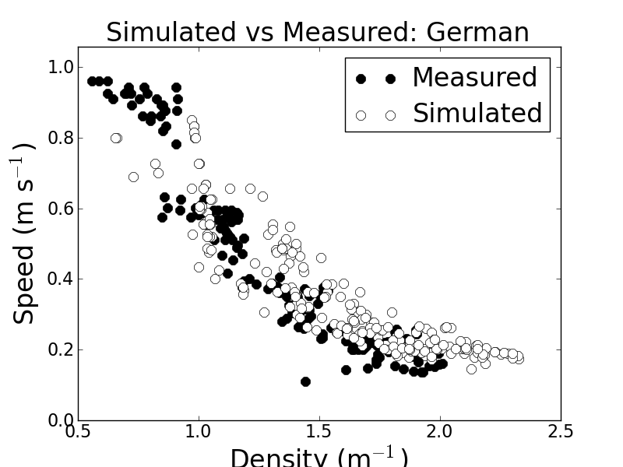
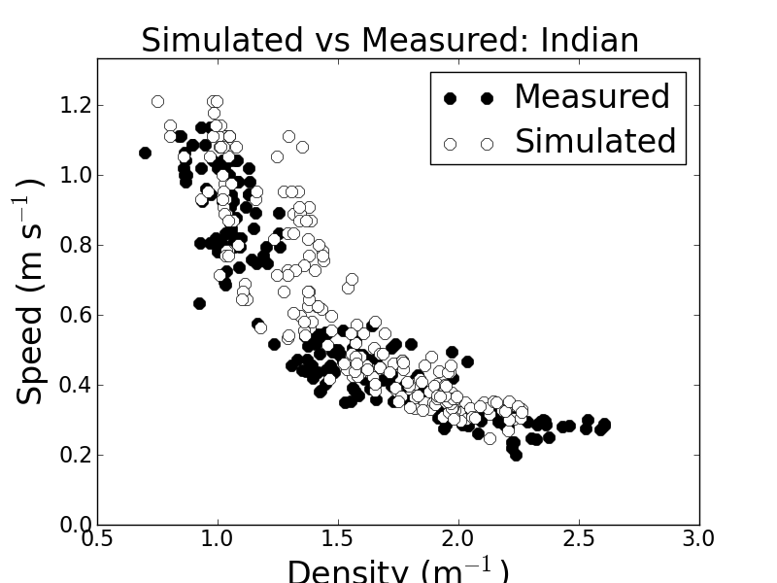
Fundamental Diagram
Density-dependent Speed
Applied to the 1D scenario
Notes:
This will be the single most controversial statement I make.

Slide 24
Space estimation
Previous equation operates on space “in front” of the agent.
S₄
4
S₃
3
S₂
2
S₁
1
S₀
0

Slide 25
Space estimation
In practical scenarios, the agent has space around it in a 2D region.
How do we map this configuration to an equivalent value for “space in front” of agent 0?
What is S₀ in order to compute v₀.
1
S₀₁
2
S₀₂
0
3
4
S₀₃
S₀₄

Slide 26
Space estimation
Principles of estimating S_{i}.
The space that matters most is in the preferred direction of travel.
Other agent’s effect on agent i‘s space depends on position, orientation and velocity, relative to i.
Each agent constricts the space; the resultant space is the most constricted space available.
We compute “effective distance” to the agents.

Slide 27
Space estimation
Illustration
d_{ji} – Euclidian distance
Δ_{ji} – Directional penalty
O_{ji} – Orientation penalty
2
2
2
Δ₂₀
d₂₀
1
Δ₁₀
1
d₁₀
0
1

Slide 28
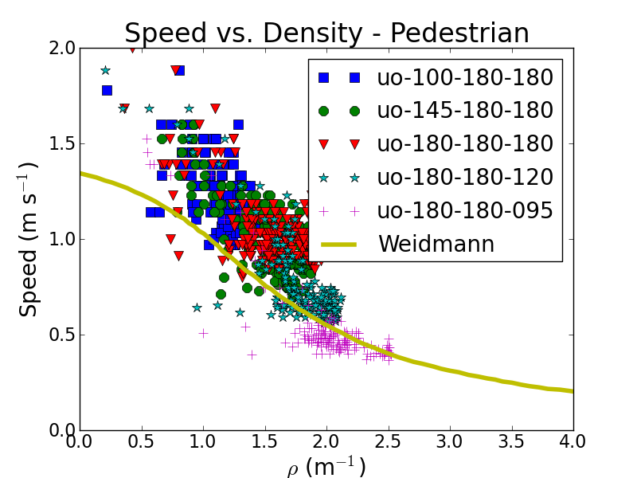
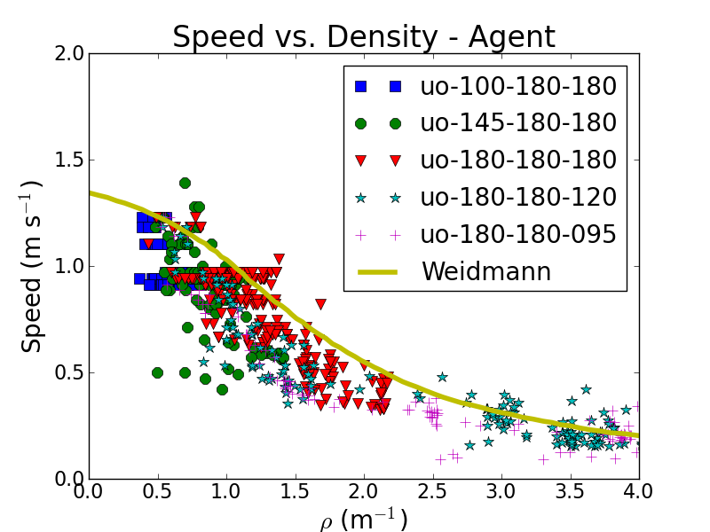
outline
Uni-directional Flow [Zhang et al. 2011]
Flow through a corridor
Vary flow into and out of the corridor to change average density.

Slide 29
outline
Observations
Same simulation parameters as 1D experiment.
Follows Weidmann’s curve [Weidmann 1993].
Overly sensitive to density.
Achieves higher density than subjects.

Slide 30
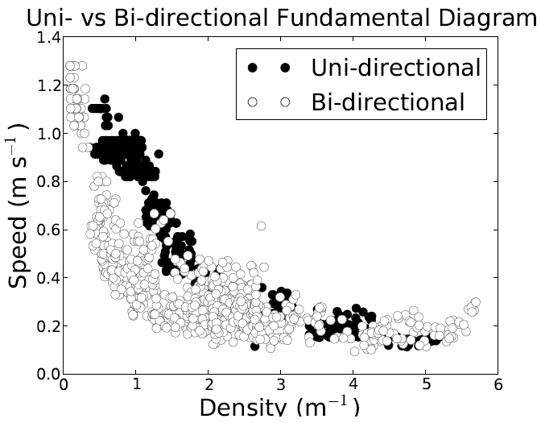
outline
Bi-directional Flow [Zhang et al. 2012]
Similar environment as uni-directional flow.
Pedestrians in bi-directional flow more sensitive to density.
Agents in bi-directional flow more sensitive to density.
Similar artifacts as uni-directional.
Too sensitive; too dense.

Slide 31
Conclusion
Light-weight approach preserves computational benefits of ORCA.
Introduces behavior consistent with observed empirical phenomena: the fundamental diagram.
Parameters map to intuitive human properties:
Stride factor
Stride buffer

Slide 32
Limitations
Space estimation seems flawed – doesn’t directly account for obstacles.
Since this submission we have investigated other space estimation models.
Reveals proclivity towards seeking high density.
This is an artifact of many agent-based crowd simulators.

Slide 33
Questions
Baseline
With Model

