Slide 1
Virtual Tawaf:
A Case Study in Simulating the Behavior of
Dense, Heterogeneous Crowds
Sean Curtis¹, Stephen J. Guy¹, Basim Zafar² and Dinesh Manocha¹
¹ University of North Carolina at Chapel Hill
² Hajj Research Institute, Umm Al-Qura University

Slide 2
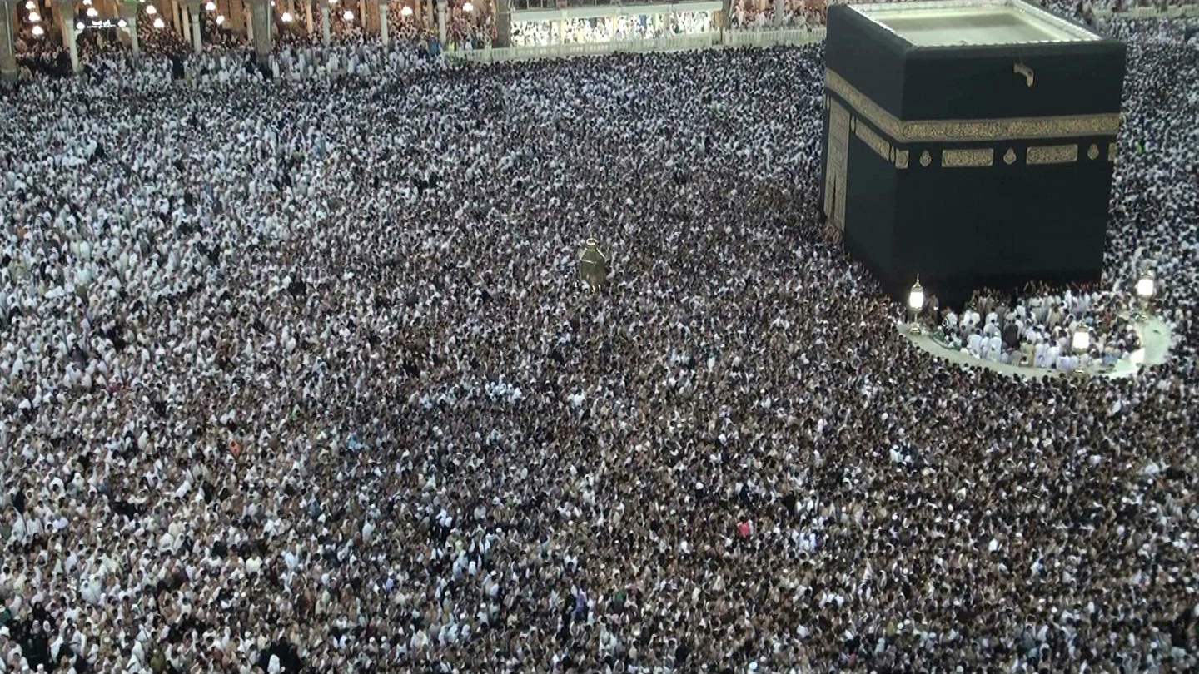
The Tawaf
University of North Carolina at Chapel Hill
2
Notes:
The Tawaf is one of the key rituals of Islam.
It is part of the Hajj, one of the pillars of Islam, and the Umrah.
Millions of muslims perform the Tawaf every year.
This is particularly remarkable because the Tawaf can only be performed in one place in the world: the holy mosque, Al masjid al haram.
Today, I’ll present our arguments for why the Tawaf is a compelling test scenario for crowd simulation and show our initial work in recreating the crowd behavior in the Tawaf in a well-principled manner.
2

Slide 3
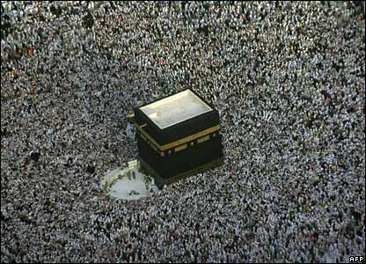
Tawaf as Case Study
Large population – 35K pilgrims.
  computationally taxing.
High density – up to 8 people/m²
  Stress the stability of the navigation method.
University of North Carolina at Chapel Hill
3
Notes:
What makes the Tawaf a good case study
Large population – 30 – 50K pilgrims. Requires an approach which is computationally tractable.
High density – local navigation methods must handle these high densities stably.
Maintaining smooth, collision-free trajectories becomes more difficult in high densities.
3

Slide 4
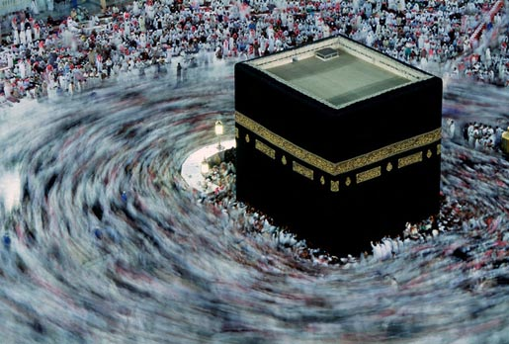
Tawaf as Case Study
University of North Carolina at Chapel Hill
4
Heterogeneous behaviors – exiting, entering, praying, etc.
Notes:
What makes the Tawaf a good case study
Heterogeneous behavior – at any given moment, agents can be engaged in different activities: exiting, entering, praying, circling, etc.
4

Slide 5
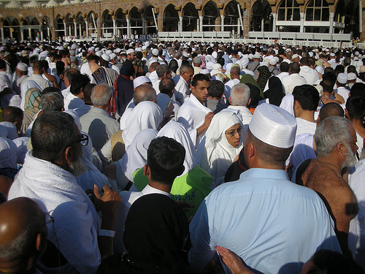
Tawaf as Case Study
University of North Carolina at Chapel Hill
5
Heterogeneous population – old/young, male/female, groups, etc.
Notes:
What makes the Tawaf a good case study
Heterogeneous population – pilgrims range over all ages and physical capacity.
5

Slide 6
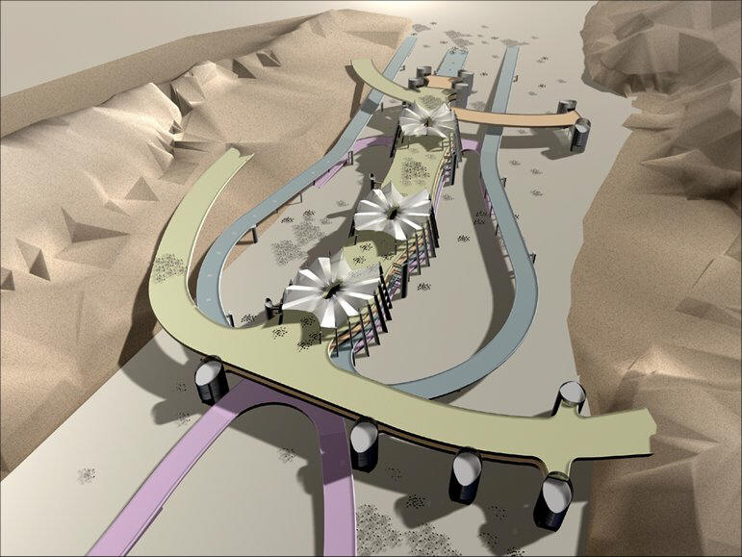
Tawaf as Case Study
University of North Carolina at Chapel Hill
6
Utility – analyze potential new designs.
Notes:
What makes the Tawaf a good case study
Finally, the Saudi government has already begun reconstruction on the Jamarat bridge, one aspect of the Hajj. It has been reported that they are investigating expansion of the Mosque to increase safety and capacity.
6

Slide 7
Related Work
University of North Carolina at Chapel Hill
7
Behavior modeling
Crowd navigation
Tawaf simulation
Notes:
Before we get into the details of the Tawaf and our simulation, I’d like to discuss some related work.
7

Slide 8
Behavior Modeling
University of North Carolina at Chapel Hill
8
Behavior which arises from the workings of the agent’s mind.
  Funge et al. 1999, Ulincy & Thalmann 2002 , Yu & Terzopoulos 2007, Yersin et al. 2009, Durupinar et al. 2010.
These model a rich space of individual behavior based on psychological models.
Notes:
Behavior modeling generally seeks to model the mind behind the agent.
These works, and others, model the thought process by modeling environment sensing, uncertainty, priorities, and other decision-dependent factors.
These models define the INTENT of an individual agent. The execution of that intent may be orthogonal.
8

Slide 9
Crowd Navigation
Cellular automata
  Blue & Adler 1998, Blue & Adler 1999, Schadschneider 2001, etc.
Rule-based
  Reynolds 1987, Shao & Terzopoulos 2005, etc.
Force-based
  Helbing & Molnar 1995 (and many variants), Yu et al. 2005, Pelechano et al. 2007, Chraibi & Seyfried 2010
Reciprocal velocity obstacle
  van den Berg et al. 2008, van den Berg et al. 2009, Guy et al. 2010
Continuum Methods
  Treuille et al. 2006, Narain et al., 2009
University of North Carolina at Chapel Hill
9
Notes:
Behavior defines what members of the crowd wants to do
Navigation is how they achieve this goal. How do they move through the space to achieve their goal without colliding with each other and their environment?
There are several basic classifications
CA – discretized workspace
Rule-based – navigation based on hand-scripted strategies
Force-based – Treat the crowd as a particle simulation
RVO – Compute the space of velocities which lead to a collision and select a velocity outside of them.
Continuum – treat the crowd as an aggregate material, solve for a velocity field and advect the agents.
I’ll cover these in a bit more detail later.
9

Slide 10
Tawaf Simulation
University of North Carolina at Chapel Hill
10
Zainuddin et al. 2009
  Used tool SimWalk to perform force-based simulation of 1000 agents.
Mulyana & Gunawam 2010
  The Hajj in general with a 500-agent Tawaf simulation.
Sarmady et al. 2010
  Used CA to simulate up to 15,000 agents.
Notes:
10

Slide 11
Crowd “Behavior”
University of North Carolina at Chapel Hill
11
Narrow band of human behavior.
  Which individual behaviors most impact aggregate crowd motion?
Two questions:
  Where does a person want to be?
  How does that person share space in achieving that goal?
Notes:
Unlike the excellent studies in simulating behaviors from a psychological perspective, we are focused on a more limited scope. We’re interested in those aspects of individual behavior which most directly contribute to the aggregate motion of a crowd of people.
For us, that comes down to two questions: where does the individual want to be? And how does he share the space with other people?
Unlike the excellent studies in simulating behaviors from a psychological perspective. We’re more interested in a descriptive interpretation of behaviors. Furthermore, we’re interested in those behaviors which define the flow in the crowd.
We’re not directly concerned with WHY a person wants to go from A to B. We’re interested in the fact that they do, and we’re interested in what strategies they apply to achieve that goal.
11

Slide 12
Crowd “Behavior”
University of North Carolina at Chapel Hill
12
Social Force example.
Where does a person want to be?
  Maps naturally to the concept of “preferred velocity”.
How does that person share space in achieving that goal?
  In social forces:
    Strength of repulsive force = ability to impart will on others.
    Mass = sensitivity to others.
Notes:
Although, in our simulation, we don’t use a social force model to simulate pilgrims, it is a well-known approach and I can efficiently illustrate the concepts by using its principles.
In social forces, the answer to the question, “Where does a person want to be?” is modeled by the preferred velocity. In the absence of obstacles, the agent would move directly toward a goal.
In social forces, the agents share space according to the force components. An agent which imparts a greater repulsive force can be thought of as aggressive. Conversely, an agent with greater mass can be thought of as insensitive to others.
12

Slide 13
System Overview
University of North Carolina at Chapel Hill
13
Behavior module determines the intent of each agent.
  Modeled with a finite state machine (FSM).
  Similar approaches used by Bandini et al. 2006, Sarmady et al. 2010, etc.
Local navigation realizes the intent.
  Computes velocity that best satisfies intent subject to constraints.
Notes:
13

Slide 14
System Overview
Agent State
Behavior FSM
Local Navigation
Intent
University of North Carolina at Chapel Hill
14
Notes:
We have to modules: one to compute the agent’s intent, the behavior finite state machine and one to execute that intent, the local navigation module.
The intent determines the direction the agent wants to travel and it’s strategy for sharing space.
The local navigation updates the agent’s state and provides that data back to the behavior module.
14

Slide 15
System Overview
University of North Carolina at Chapel Hill
15
A behavior/intent is determined by a node in a FSM.
States define:
  Preferred velocity
  Local navigation parameters (how agents share space.)
Notes:
15

Slide 16
System Overview
University of North Carolina at Chapel Hill
16
Local Navigation
  We’ve selected Reciprocal Velocity Obstacles (RVO) as the local navigation module.
  Why RVO?
Notes:
16

Slide 17
System Overview
University of North Carolina at Chapel Hill
17
Cellular automata
  Space discretization leads to artifacts
    Homogeneous agent speeds
    Limits maximum density
Notes:
The first reason is that cellular automata has already been examined. Sarmaday et al. simulated 15K agents performing the Tawaf.
The authors acknowledge that the nature of cellular automata mean that individual agent trajectories are not physically accurate, but the aggregate effect is promising.
17

Slide 18
System Overview
Repulsive Force
force
distance
University of North Carolina at Chapel Hill
18
Force-based
  Using forces for collision avoidance leads to stiff systems.
  In dense scenarios, force
  response is very sensitive and
  requires small time step.
Notes:
Force-based simulations use forces to perform collision avoidance.
In order to keep the repulsive response local, the repulsive force falls off quickly.
When the scenario is sparsely populated and the agents can reach an equilibirum of reasonable distances, small changes in distance lead to small changes in force. Larger time steps are accetpable.
However, when agents are near each other, such as in high-density scenarios, the repulsion response varies significantly with small changes in distance. To remain stable, explicit integration methods must take very small time steps.
In addition, force-based models require extensive tuning.
18

Slide 19
System Overview
Repulsive Force
force
Repulsive Force Magnitude
distance
University of North Carolina at Chapel Hill
19
Force-based
Notes:
Here’s a brief example to illustrate it.
The blue agent is nearer the yellow agent than the red. The yellow’s repulsive force is significantly more than the red’s.
19

Slide 20
System Overview
Force-based
Repulsive Force
force
Repulsive Force Magnitude
distance
University of North Carolina at Chapel Hill
20
Notes:
When the system is integrated, the blue agent moves closer to the red and the relative strengths of the forces switches.
This repeats itself and the agents oscillate.
An equilibrium exists, but can only be reached with a very small time step.
20

Slide 21
System Overview
University of North Carolina at Chapel Hill
21
Velocity Obstacle
Notes:
Here the blue agent moves from left to right.
If position alone mattered, the blue agent would have to adapt its path to avoid the yellow agent.
However, when we consider velocities, we note that the yellow agent does not actually interfere with the blue agent’s path.
The red does.
21

Slide 22
System Overview
University of North Carolina at Chapel Hill
22
Velocity Obstacle
  Geometric approach
  Computes collision-free velocity directly in velocity space.
  Only avoid those for whom a collision is probable.
Notes:
Velocity obstacles
A set of relative velocities which would lead to collision.
The obstacle is a cone in velocity space.
If we limit the time horizon the cone is truncated.
Selecting a velocity outside of the obstacle will be collision free.
22

Slide 23

System Overview
University of North Carolina at Chapel Hill
23
Velocity Obstacle
  Which velocities are collision free?
Notes:
Velocity obstacles
A set of relative velocities which would lead to collision.
The obstacle is a cone in velocity space.
If we limit the time horizon the cone is truncated.
Selecting a velocity outside of the obstacle will be collision free.
23

Slide 24

System Overview
University of North Carolina at Chapel Hill
24
Velocity Obstacle
  Space of relative velocities which lead to collision.
Notes:
Velocity obstacles
A set of relative velocities which would lead to collision.
The obstacle is a cone in velocity space.
If we limit the time horizon the cone is truncated.
Selecting a velocity outside of the obstacle will be collision free.
24

Slide 25
System Overview
University of North Carolina at Chapel Hill
25
Velocity Obstacle
  Assumptions of 1-sided avoidance leads to oscillation.
  Reciprocal Velocity Obstacle
  Reciprocity
    VO reports required change in relative velocity.
    The change is shared between the agents by symmetrically displacing velocity obstacles.
Notes:
Velocity obstacles
A set of relative velocities which would lead to collision.
The obstacle is a cone in velocity space.
If we limit the time horizon the cone is truncated.
Selecting a velocity outside of the obstacle will be collision free.
25

Slide 26
System Overview
University of North Carolina at Chapel Hill
26
Velocity Obstacle
  Multiple neighbors
Notes:
Velocity obstacles
A set of relative velocities which would lead to collision.
The obstacle is a cone in velocity space.
If we limit the time horizon the cone is truncated.
Selecting a velocity outside of the obstacle will be collision free.
26

Slide 27
System Overview
University of North Carolina at Chapel Hill
27
Velocity Obstacle
  Multiple neighbors → multiple VOs.
Notes:
Velocity obstacles
A set of relative velocities which would lead to collision.
The obstacle is a cone in velocity space.
If we limit the time horizon the cone is truncated.
Selecting a velocity outside of the obstacle will be collision free.
27

Slide 28
System Overview
University of North Carolina at Chapel Hill
28
Velocity Obstacle
  If preferred velocity is outside – take it.
Notes:
Velocity obstacles
A set of relative velocities which would lead to collision.
The obstacle is a cone in velocity space.
If we limit the time horizon the cone is truncated.
Selecting a velocity outside of the obstacle will be collision free.
28

Slide 29
System Overview
University of North Carolina at Chapel Hill
29
Velocity Obstacle
  If preferred velocity is inside –
Notes:
Velocity obstacles
A set of relative velocities which would lead to collision.
The obstacle is a cone in velocity space.
If we limit the time horizon the cone is truncated.
Selecting a velocity outside of the obstacle will be collision free.
29

Slide 30
System Overview
University of North Carolina at Chapel Hill
30
Velocity Obstacle
  If preferred velocity is inside – take “best” alternative.
Notes:
Velocity obstacles
A set of relative velocities which would lead to collision.
The obstacle is a cone in velocity space.
If we limit the time horizon the cone is truncated.
Selecting a velocity outside of the obstacle will be collision free.
30

Slide 31
System Overview
University of North Carolina at Chapel Hill
31
Velocity Obstacle
  “Best” alternative can be found very efficiently.
    van den Berg 2010
  Stability of geometric computation is not dependent on distance or change in distance.
    Leads to stable simulations with relatively large time steps (~ 0.1s ).
Notes:
Given a desired velocity determined by behavior, we select a feasible velocity outside the velocity obstacle.
31

Slide 32
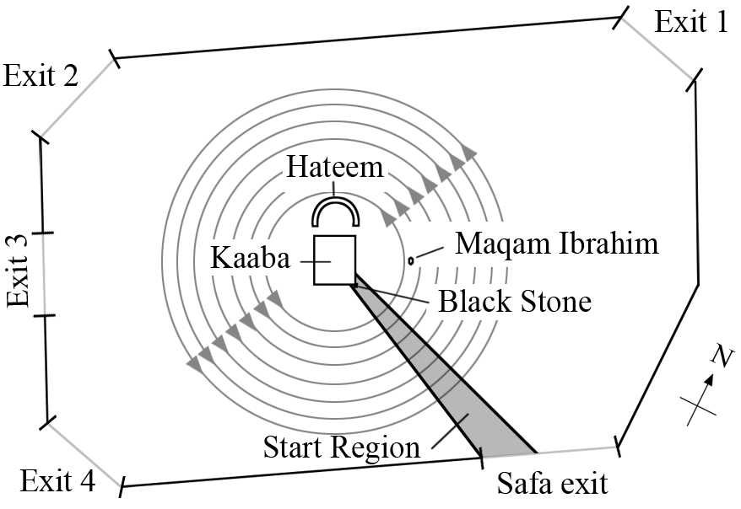
Tawaf State Machine
Performance of Tawaf
  Pilgrims enter and circle the Kaaba seven times.
  Perform Istilam, a short prayer, after each circle.
  Try to touch the Black Stone.
  Exit after seven circles.
University of North Carolina at Chapel Hill
32
Notes:
32

Slide 33
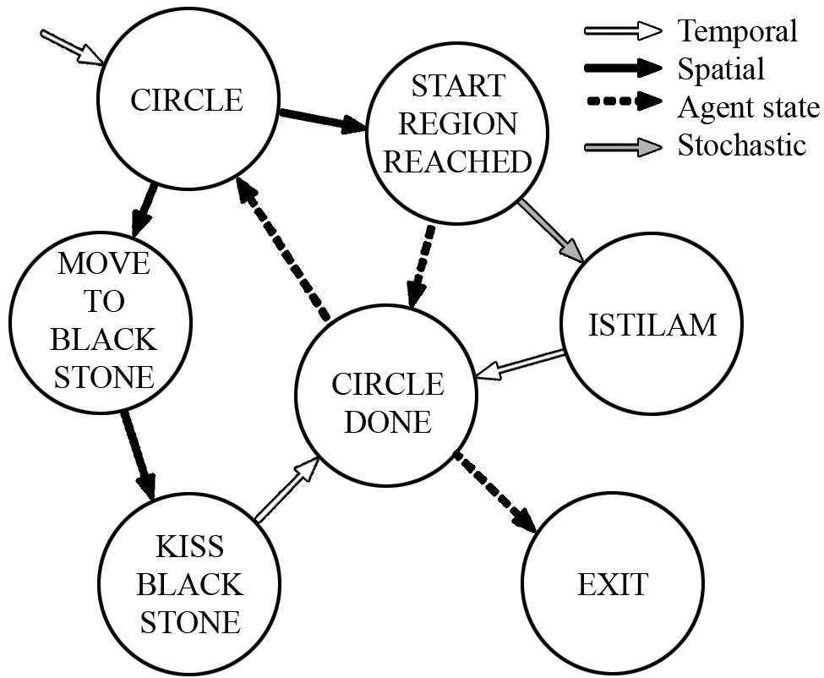
Tawaf State Machine
University of North Carolina at Chapel Hill
33
Notes:
Here is the FSM as outlined in the paper. The performance of the Tawaf is encoded in this machine.
In the interest of time, we’ll look at two related states to see how the Behavior FSM works with the Local Navigation to create crowd behavior.
33

Slide 34


CIRCLE State
+
radial
tangential
University of North Carolina at Chapel Hill
34
Circumambulatory behavior
  Linear combination of two navigation fields: radial (R) and tangential (T): v = α R + T
  Magnitude of α → draw towards Kaaba.
Notes:
Circling behavior is done through a linear combination of two navigation fields.
Radial navigation field have velocities pointing to the center
Tangential navigation field has velocities which take the agents around the Kaaba (and tangential to the obstacles)
Increased weight of the radial field causes the agent to draw towards the Kaaba.
A greater weight models a greater desire to approach the Kaaba.
34

Slide 35
Experiment
0.48 m
0.3 m
0.38 m
University of North Carolina at Chapel Hill
35
35K agents
  Uniformly divided into four demographic categories.
  Initial state: uniform distribution of progress through the ritual and position around Kaaba.
  Uniform radius of 0.17 m equivalent to ellipse of human size → maximum density 8 agents/m².
Notes:
35

Slide 36
Results
University of North Carolina at Chapel Hill
36
Highly efficient and stable
  Simulating 35K agents at 26 Hz ( 38 ms per frame).
    Intel i7 @ 2.67 GHz
  Simulation stable for large time step of 0.1s
  Able to produce 2.6 s of simulation in 1 s real time.
Notes:
36

Slide 37
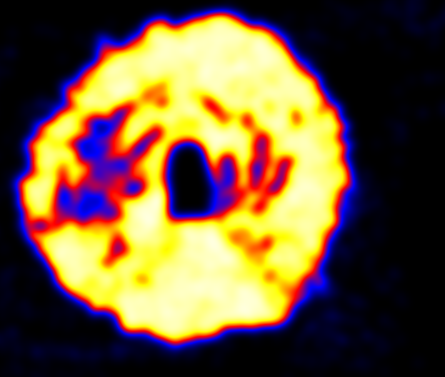
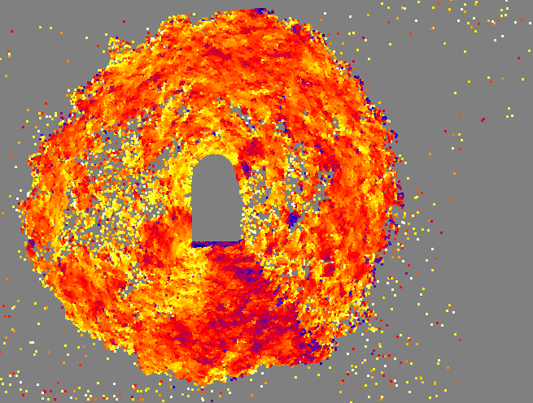


Results
Density (agent/m²)
Speed (m/s)
University of North Carolina at Chapel Hill
37
Speed vs. Density
  Mean observed speed < mean preferred speed.
  Reduced speed due to density.
Notes:
37

Slide 38
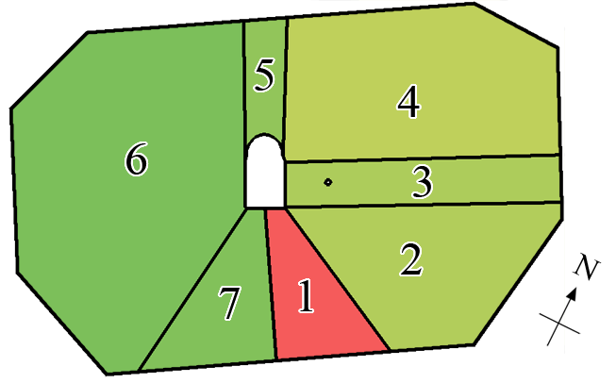
Results
University of North Carolina at Chapel Hill
38
Region-based analysis
  Measured average speed based on region.
  Strong correlations to Koshak & Fouda 2008:
    Region 1 is the slowest
    Regions 5-7 exhibit higher speeds than regions 1-4.
    Highest speeds match.
  Slow down in 4 due to
  narrowing space.
Notes:
38

Slide 39
Limitations
University of North Carolina at Chapel Hill
39
Not all Tawaf elements are modeled.
  Groups
Large-scale results correlate well with data.
  Small-scale details need improvement.
Requires validation
  We need more data of Tawaf performance.
Notes:
Groups are an important element of the Tawaf
Validation
The challenge is extracting meaningful data of a crowd consisting of tens of thousands of people at high density.
39

Slide 40
Future Work
University of North Carolina at Chapel Hill
40
Investigate training behavior states by data.
Apply same principles to alternative navigation methods
  Currently working on GCF-based approach (Chraibi et al. 2010)
Increase space of behaviors to include grouping.
Notes:
40

Slide 41
Conclusion
University of North Carolina at Chapel Hill
41
We’ve proposed the Tawaf as a practical and meaningful case study for dense crowd simulation.
We’ve proposed and shown a mechanism for modeling the complex and dynamic behaviors exhibited by pilgrims performing the Tawaf.
  Simulated results correlate well with observed phenomena.
Notes:
41

Slide 42
Acknowledgments
University of North Carolina at Chapel Hill
42
This research is supported in part by ARO Contract W911NF-10-1-0506, NSF awards 0917040, 0904990 and 1000579.
Notes:
42

