Slide 1
Ray Tracing
Dinesh Manocha
COMP 575/770

Slide 2
Overview
Review
Ray Tracing flavors
  Recursive ray tracing
  Distributed ray tracing
Ray Tracing vs. rasterization

Slide 3
Overview
Review
Ray Tracing flavors
  Recursive ray tracing
  Distributed ray tracing
Ray Tracing vs. rasterization

Slide 4
What is Ray Tracing?
Ray-Generation
Ray-Traversal
Intersection
Shading
Framebuffer

Slide 5
What is Ray Tracing?
Ray-Generation
Ray-Traversal
Intersection
Shading
Framebuffer

Slide 6
What is Ray Tracing?
Ray-Generation
Ray-Traversal
Intersection
Shading
Framebuffer

Slide 7
What is Ray Tracing? Traversal
Ray-Generation
Ray-Traversal
Intersection
Shading
Framebuffer

Slide 8
What is Ray Tracing?
Ray-Generation
Ray-Traversal
Intersection
Shading
Framebuffer

Slide 9
What is Ray Tracing?
Ray-Generation
Ray-Traversal
Intersection
Shading
Framebuffer

Slide 10
What is Ray Tracing?
Ray-Generation
Ray-Traversal
Intersection
Shading
Framebuffer

Slide 11
Secondary Rays: Shadow Rays
Light
Shadow ray
Viewer
If first hit of shadow ray closer than distance to light ⇨ in shadow

Slide 12
Secondary Rays: Reflection Rays
Light
Reflection ray
Viewer

Slide 13
Computing Reflection Rays
Reflection is pretty simple
  Incident angle = Exit angle
    Incident ray: x + t*d
    Reflection ray: a + t*(d – 2*n*dot(n,d))
    (careful, assumes n and d normalized!)
n
a

Slide 14
Secondary Rays: Refraction Rays
Light
Refraction ray
Viewer

Slide 15
Computing Refraction Rays
Refraction occurs at material boundaries
  E.g. air-glass
  Depends on refractive index n of materials
Snell’s law:
  n ₁ * sin(θ₁) = n₂ * sin(θ₂)
Special case:
  total internal reflection
    denser to less dense material
    θ > critical angle
n₁
θ₁
n₂
θ₂

Slide 16
Overview
Review
Ray Tracing flavors
  Recursive ray tracing
  Distributed ray tracing
Ray Tracing vs. rasterization

Slide 17
Where’s the recursion?
Light
Reflection ray
Reflection ray
Viewer
Refraction ray

Slide 18
Computing ray colors
How to get the final pixel color?
  Every material has local color c
  Define reflexivity, refraction factors ρ
  (i.e. between 1.0 (mirror) and 0.0 (no reflection)
  Each hit returns its color down the chain
End result:
  Color = (1 –ρ) c₁ + ρ₁ ( (1- ρ₂)c₂ + ρ₂ (c_{3 ….} )))
  Local color also influenced by shadow rays!

Slide 19
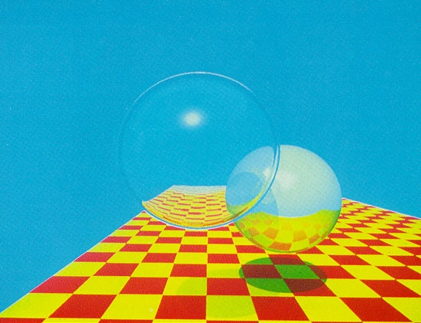
Recursive Ray Tracing: Example
(from [Whitted80])

Slide 20
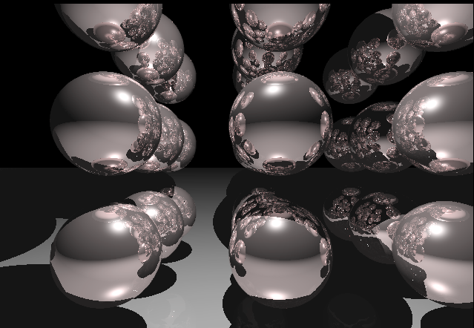
Recursive Ray Tracing: Example

Slide 21
Overview
Ray Tracing vs. rasterization
Ray Tracing methods
  Recursive ray tracing
  Distributed ray tracing
Ray/Object intersection algorithms

Slide 22
Distributed ray tracing
Ray Tracing: too idealistic!
  No point light sources in nature
  No perfect reflections etc.
Distributed ray tracing idea
  Substitute exact single rays with several probabilistically generated rays

Slide 23
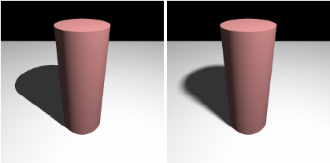
Distributed Ray Tracing
Allows many physically correct effects:
  Soft area shadows
  Glossy, imperfect reflections and refractions
  Depth of Field
  Motion blur
(from [Boulos07])

Slide 24
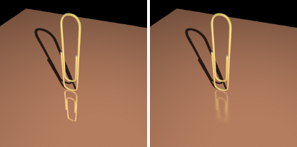
Distributed Ray Tracing
Allows many physically correct effects:
  Soft area shadows
  Glossy, imperfect reflections and refractions
  Depth of Field
  Motion blur
(from [Boulos07])

Slide 25
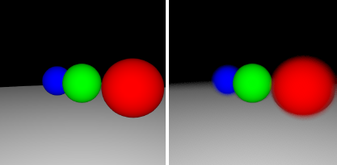
Distributed Ray Tracing
Allows many physically correct effects:
  Soft area shadows
  Glossy, imperfect reflections and refractions
  Depth of Field
  Motion blur
(from [Boulos07])

Slide 26
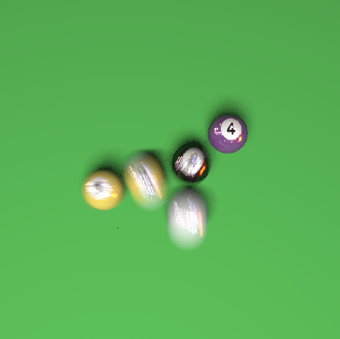
Distributed Ray Tracing
Allows many physically correct effects:
  Soft area shadows
  Glossy, imperfect reflections and refractions
  Depth of Field
  Motion blur
(from [Boulos07])

Slide 27
Area shadows with DRT
Light
Shadow ray
Viewer

Slide 28
Area shadows with DRT
n shadow rays for randomly
selected points on light
Area light
Viewer
Lighting now determined by #rays reach light / #rays shot

Slide 29
Other effects
Reflections, Refraction similar
  E.g. sample rays inside cone defined by direction
Depth of field
  Sample different viewer positions on lens
Motion blur
  Sample different time points
All work together!

Slide 30
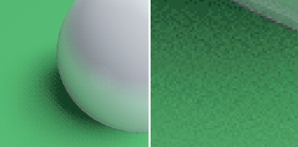
Stochastic sampling
One new disadvantage:
sampling needs to be high, or artifacts visible
  Manifests as high-frequency noise
  Good sample generation is art in itself
  Much, much slower than simple ray tracing
(from [Boulos07])

Slide 31
Overview
Review
Ray Tracing flavors
  Recursive ray tracing
  Distributed ray tracing
Ray Tracing vs. rasterization

Slide 32
Rasterization
Viewer
Screen

Slide 33
Ray Tracing
Viewer
Screen

Slide 34
Rasterization vs. Ray Tracing
Rasterization
  For each primitive:
    For each pixel:
      Is Pixel in Primitive?
        Yes: Test depth / write color
Ray Tracing
  For each pixel: generate ray
    For each primitive:
      Does ray hit primitive?
        Yes: Test depth / write color

Slide 35
Ray Tracing
“Tracing a ray” = find first hit with scene object
Naïve:
  Test against all scene objects
  Like testing all pixels in rasterization!
In reality:
  Acceleration structure gives quick estimate of potentially visible objects for ray
  (topic of 2nd lection on RT)

Slide 36
Rasterization vs. Ray Tracing
3D object space index (e.g. kd-tree)
  Limits scene dynamics (may require index rebuilt)
  Increases scalability with scene size → O(log n)
  Efficiently supports small & arbitrary sets of rays
    Few rays reflecting off of surface → ray tracing problem
2D image space grid
  Rays limited to regular sampling & planar perspective
Notes:
See previous slide.

Slide 37
Rasterization vs. Ray Tracing
Hardware Support
  Rasterization has mature & quickly evolving HW
    High-performance, highly parallel, stream computing engine
  Ray tracing mostly implemented in SW
➔ Not well supported by current HW

Slide 38
Requirements for
Realtime Ray Tracing
Requirements
  High floating point performance
    Traversal & intersection computations
  Flexible control flow, multiple threads
    Recursion, efficient traversal of kd-tree, …
  Exploitation of coherence
    Caching, packets, efficient traversal, …
  High bandwidth
    Between traversal, intersection, and shading; to caches

Slide 39
Ray Tracing algorithms
So what’s the big deal?
Ray Tracing far more flexible paradigm
  Not limited to primary visibility!
  Highly realistic images by default
  Physical correctness and dependability
  Support for massive scenes
  Integration of many different primitive types
  Declarative scene description
  Global illumination

Slide 40
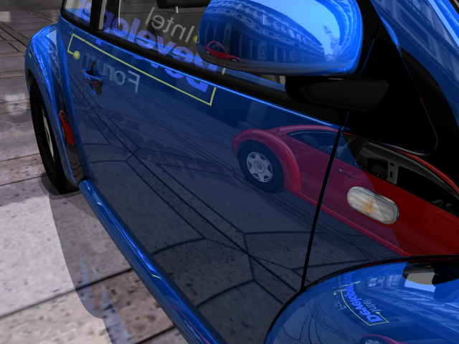
Reasons for Using Ray Tracing
Highly Realistic Images
Volkswagen Beetle with correct shadows and (multi-)reflections on curved surfaces

Slide 41
Reasons for Using Ray Tracing
Physical Correctness
Physical Correctness and Dependability
  Numerous approximations caused by rasterization
  Might be good enough for games (but maybe not?)
  Industry needs dependable visual results
Benefits
  Users develop trust in the visual results
  Important decisions can be based on virtual models

Slide 42
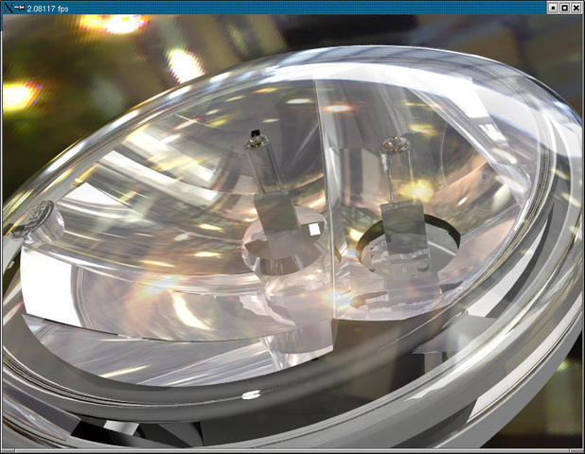
Reasons for Using Ray Tracing
Physical Correctness
Fully ray traced car head lamp, faithful visualization requires up to 50 rays per pixel

Slide 43
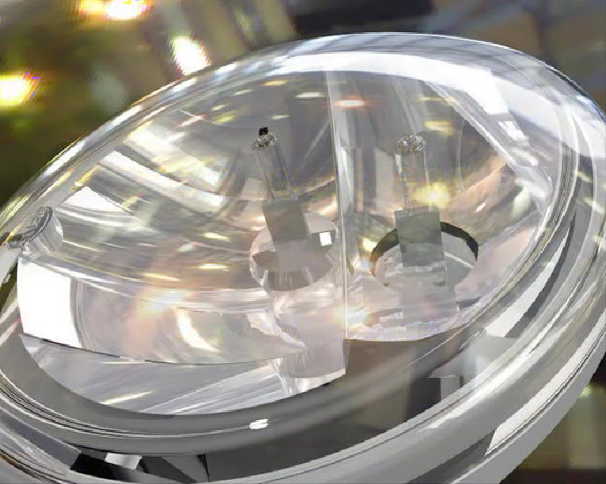
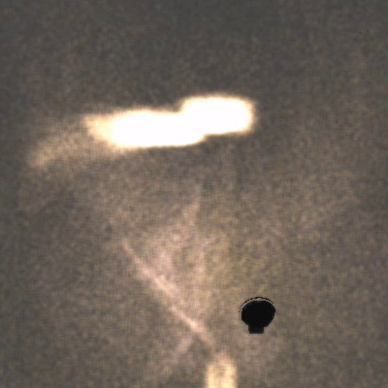
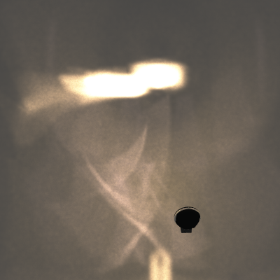
Reasons for Using Ray Tracing
Physical Correctness
250k / 3 fps
25M / 11 fps
Light pattern from a car head lamp computed in realtime using photon mapping:
Left: realtime update, middle: accumulated in 30s, right: photograph of real pattern

Slide 44
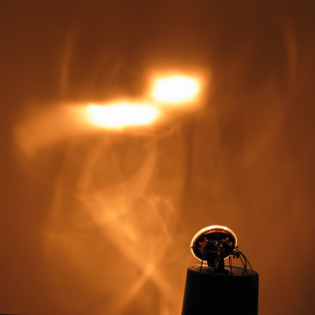
Reasons for Using Ray Tracing
Physical Correctness
250k / 3 fps
25M / 11 fps
Photograph
Light pattern from a car head lamp computed in realtime using photon mapping:
Left: realtime update, middle: accumulated in 30s, right: photograph of real pattern

Slide 45
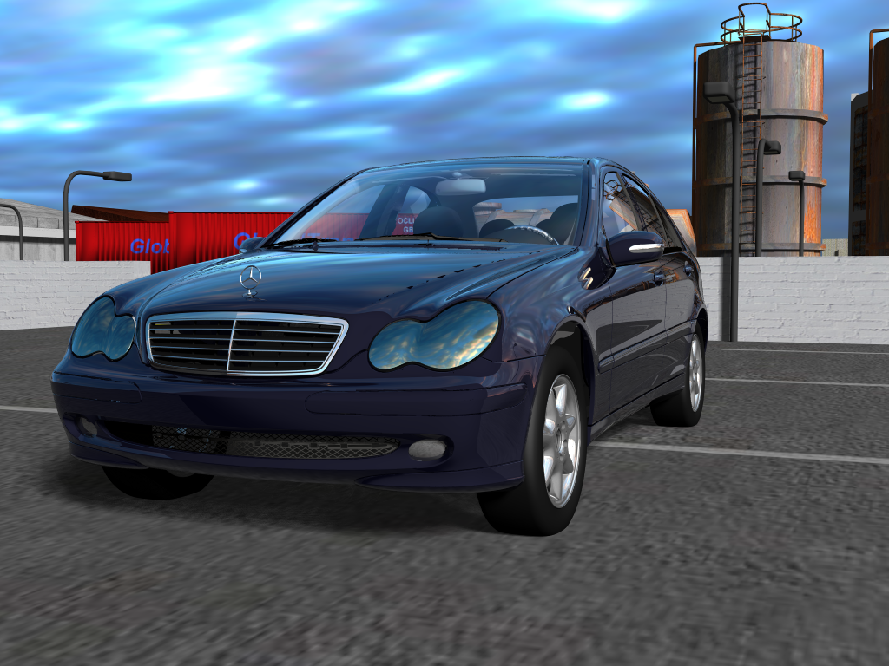
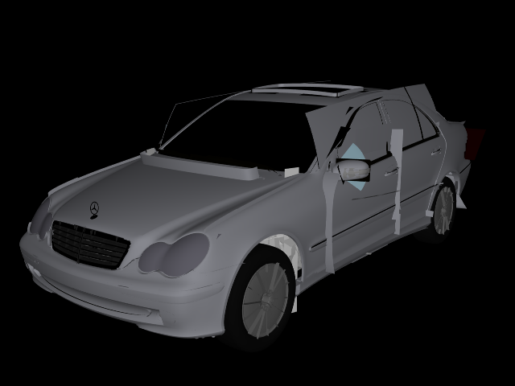
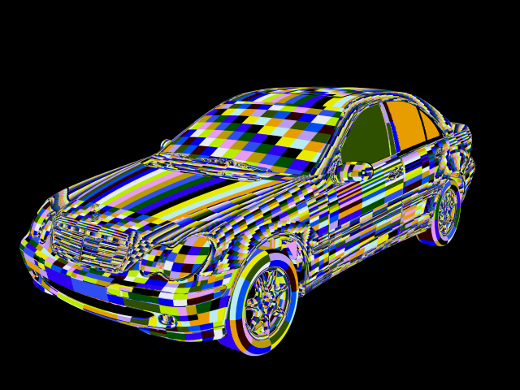
Reasons for Using Ray Tracing
Physical Correctness
Rendered directly from trimmed NURBS surfaces, with smooth environment lighting

Slide 46
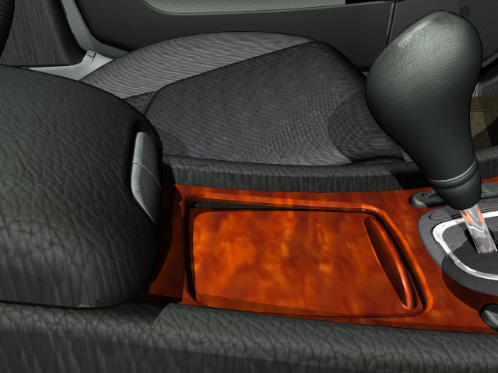
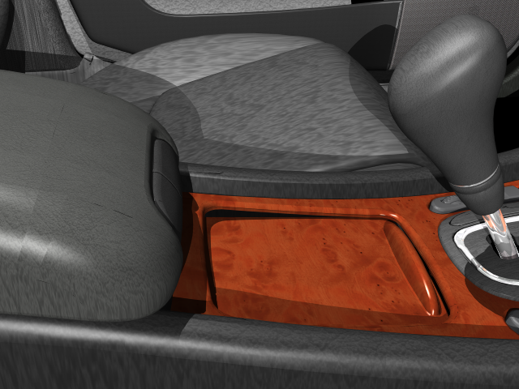
Reasons for Using Ray Tracing
Physical Correctness
Textured Phong for
comparison
Rendered with accurately measured BTF data
that accounts for micro lighting effects
BTF Data Courtesy R. Klein, Uni Bonn

Slide 47
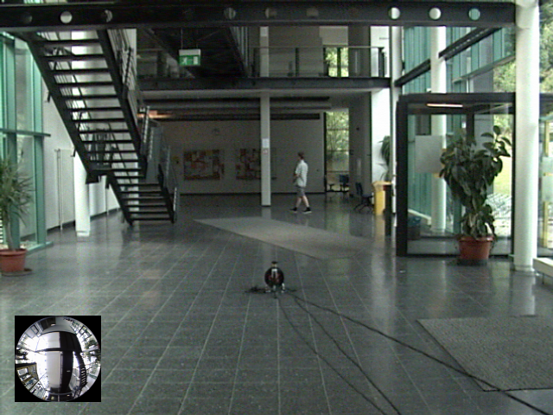
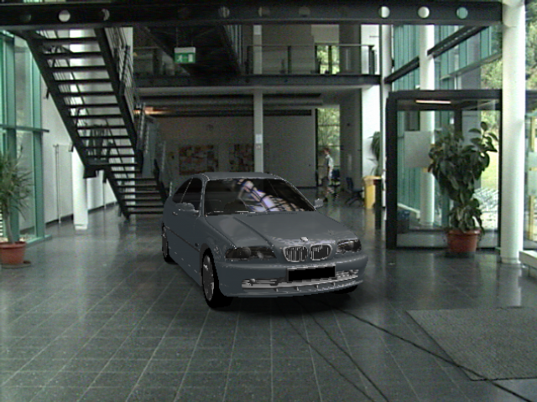
Reasons for Using Ray Tracing
Physical Correctness
VR scene illuminated from realtime video feed, AR with realtime environment lighting

Slide 48
Reasons for Using Ray Tracing
Massive Models
Massive Scenes
  Scales logarithmically with scene size
  Supports billions of triangles
Benefits
  Can render entire CAD models without simplification
  Greatly simplifies and speeds up many tasks

Slide 49
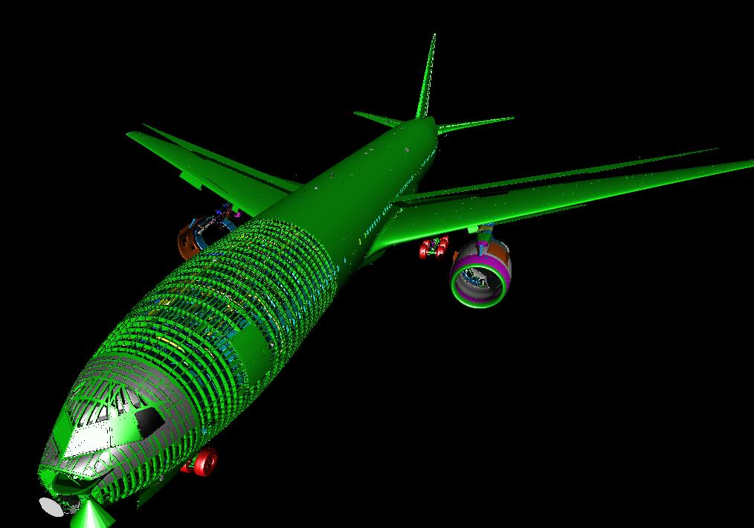
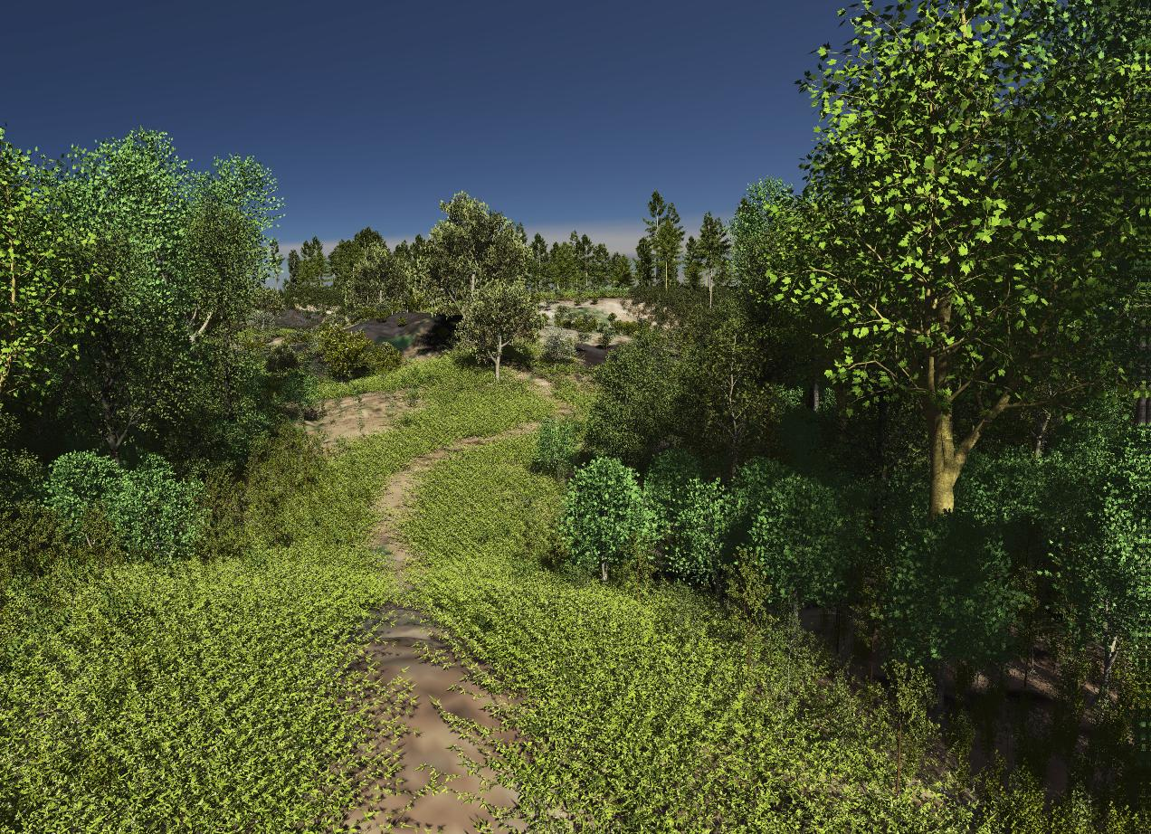
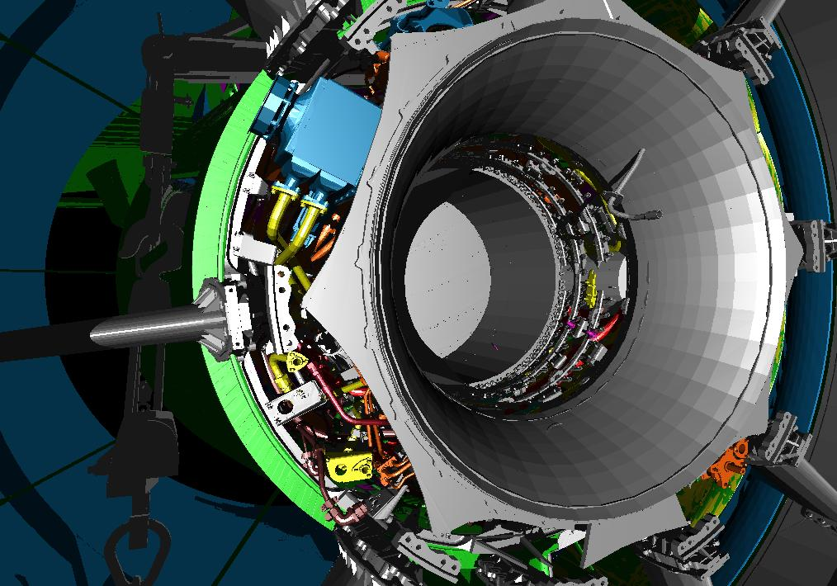
Reasons for Using Ray Tracing
Massive Models

Slide 50
Reasons for Using RTRT:
Flexible Primitive Types
Flexible Primitive Types
  Triangles
  Volumes data sets
    Iso-surfaces & direct visualization
    Regular, rectilinear, curvilinear, unstructured, …
  Splines and subdivision surfaces
  Points

Slide 51
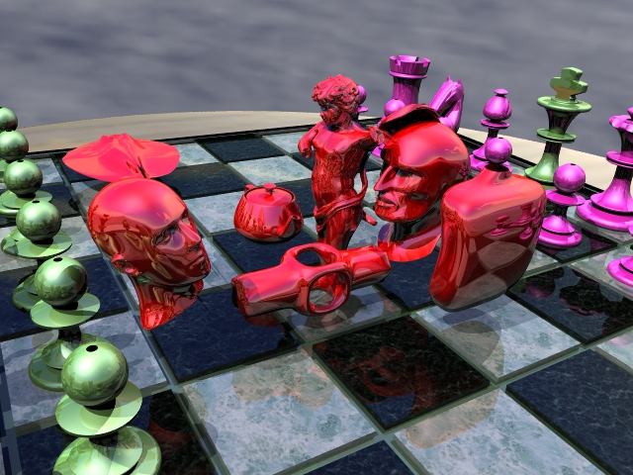
Reasons for Using Ray Tracing
Flexible Primitive Types
Triangles, Bezier splines, and subdivision surfaces fully integrated

Slide 52
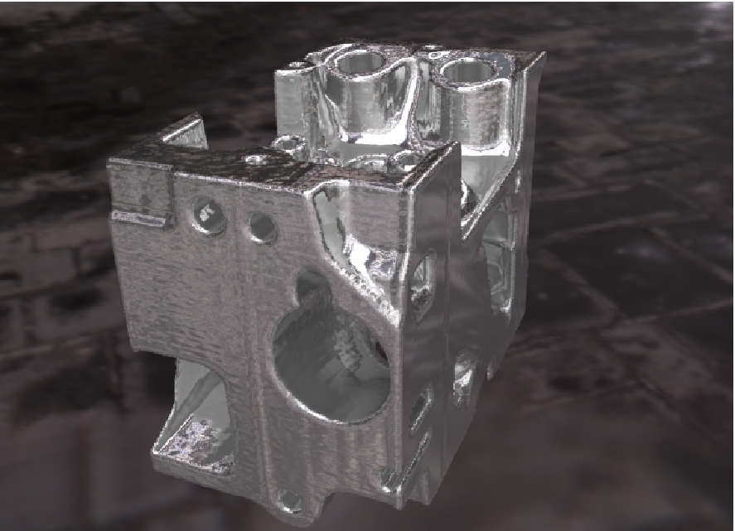
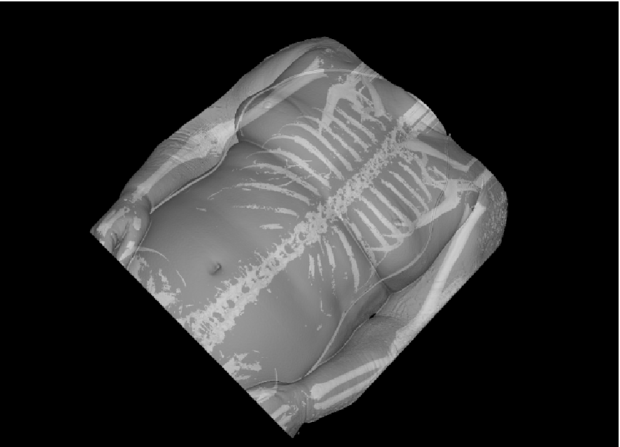
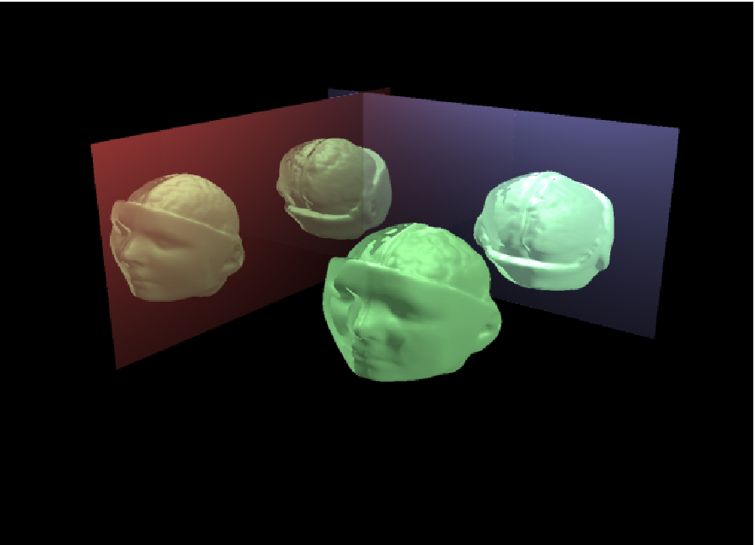
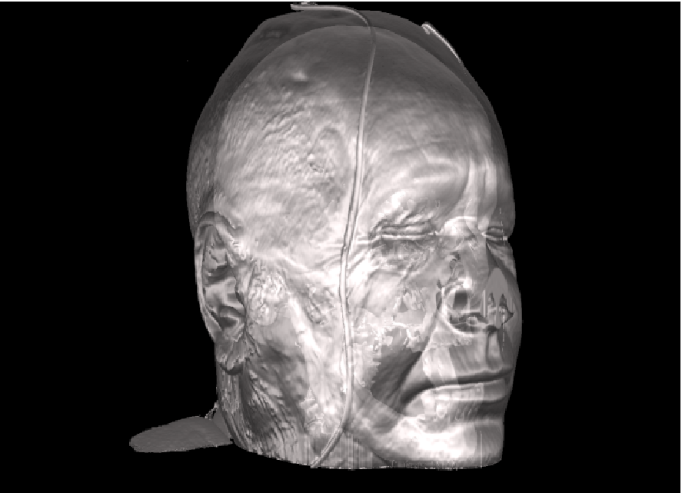
Reasons for Using Ray Tracing
Flexible Primitive Types
Volume visualization using multiple iso-surfaces in combination with surface rendering

Slide 53
Reasons for Using Ray Tracing
Flexible Primitive Types
24 MPoints, 2.1 fps with shadow @ 640x480
Realtime ray tracing of point clouds (1 Mpoints each)
On one dual-Opteron 2.4 GHz: 4-9 fps

Slide 54
Reasons for Using Ray Tracing
Declarative Graphics
Declarative Graphics Interface
  Application specifies scene once, plus updates
  Rendering fully performed by renderer (e.g. in HW)
  Similar to scene graphs, PostScript, or latest GUIs
Benefits
  Greatly simplifies application programming
  Allows for complete HW acceleration

Slide 55
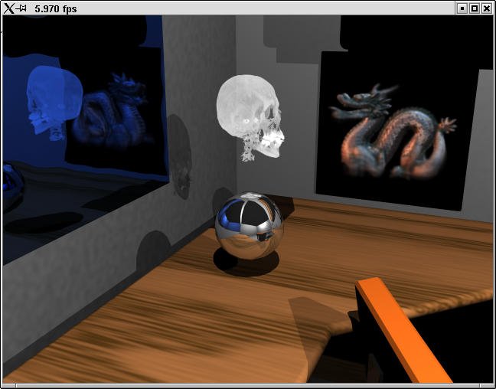
Reasons for Using Ray Tracing
Declarative Graphics

Slide 56
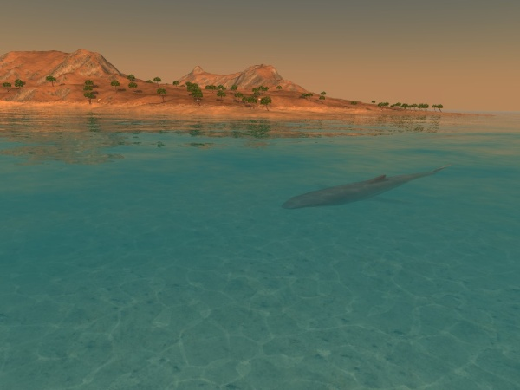
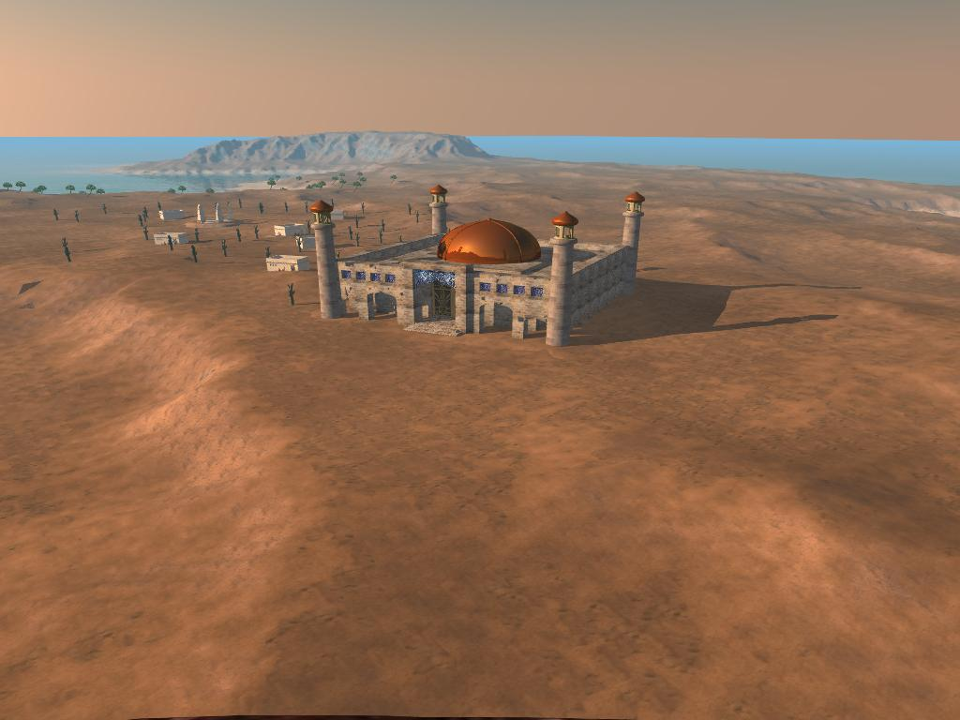
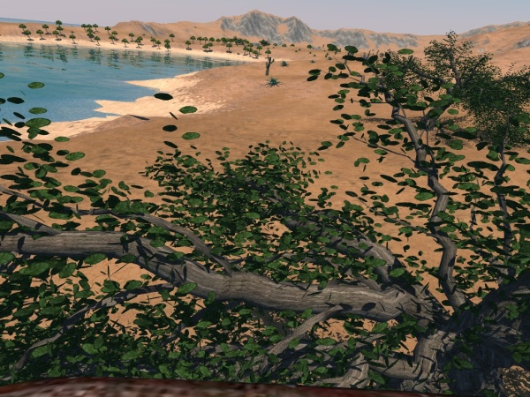
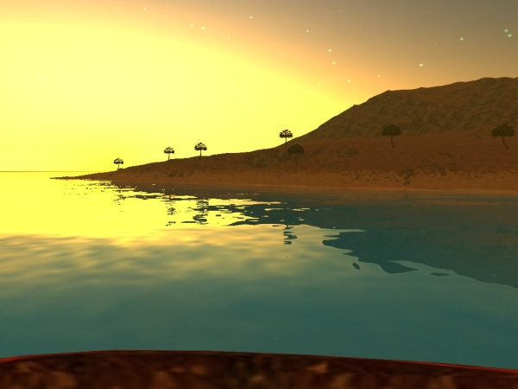
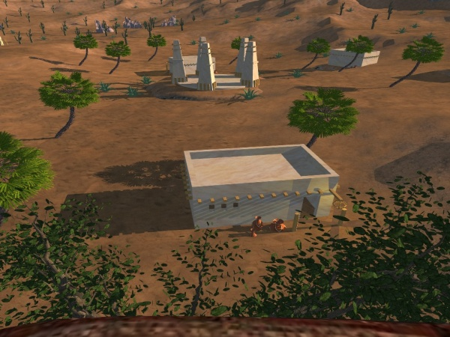
Reasons for Using Ray Tracing
Declarative Graphics

Slide 57
Reasons for Using Ray Tracing
Global Illumination
Global Illumination
  Simulating global lighting through tracing rays
  Indirect diffuse and caustic illumination
  Fully recomputed at up to 20 fps
Benefits
  Add the subtle but highly important clue for realism
  Allows flexible light planning and control

Slide 58
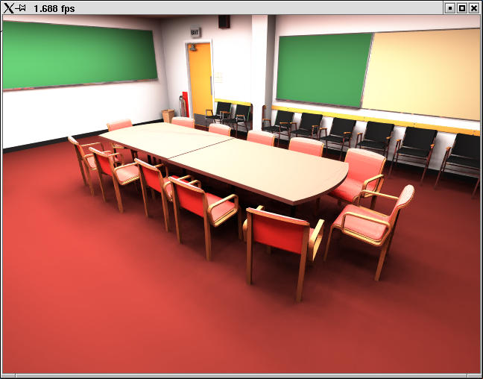
Reasons for Using Ray Tracing
Global Illumination
Conference room (380 000 tris, 104 lights) with full global illumination in realtime

Slide 59
Conclusion
Ray Tracing advantages
  Reflections, refraction, shadows
  Rendering of arbitrary objects
    Does not even need explicit representation
  Used for global illumination, many others
Disadvantages
  Usually much slower
  (no hardware acceleration, either)

