Slide 1
Velocity Obstacles for Multi-agent Navigation
Course lecture for comp790-058
Nov. 7th, 2017
Zhenyu Tang

Slide 2
Overview
Velocity Obstacle (VO) is a well studied method in collision avoidance problems
It requires no communication between agents or central coordination
It is efficient for real-time collision avoidance
Extensions of VO include
  Reciprocal Velocity Obstacle (RVO)
  Hybrid Reciprocal Velocity Obstacle (HRVO)
  Optimal Reciprocal Collision Avoidance (ORCA)
  Reciprocal Collision Avoidance with Elliptical Agents (EORCA)
  Reciprocally-Rotating Velocity Obstacles (RRVO)
  and potentially more…

Slide 3
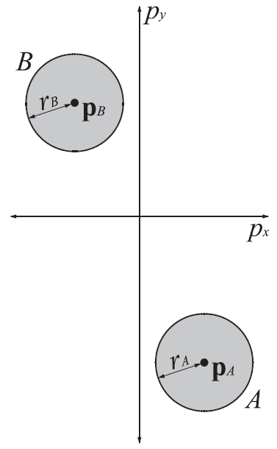
Problem Definition
Simplest case: two disk-shaped agents
Different current velocity
Will they collide and if so, how to avoid?

Slide 4
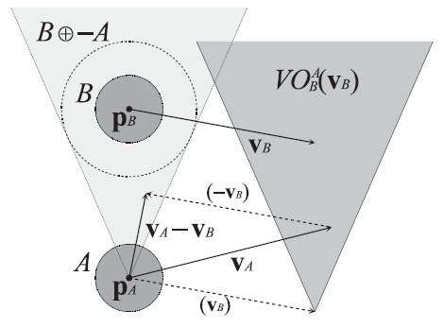


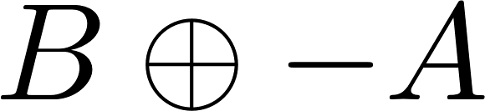
Velocity Obstacle (VO)
The set consisting of all those velocities for A that will result in a collision at some moment in time B moving at velocity .
The Velocity Obstacle divides velocity space of A into two distinct sets. If is inside , they will collide in the next moment; otherwise they are collision free in the next moment
Formally:
The Velocity Obstacle of obstacle B to agent A
Fiorini, P., & Shiller, Z. (1998). Motion planning in dynamic environments using velocity obstacles. The International Journal of Robotics Research, 17(7), 760-772.

Slide 5
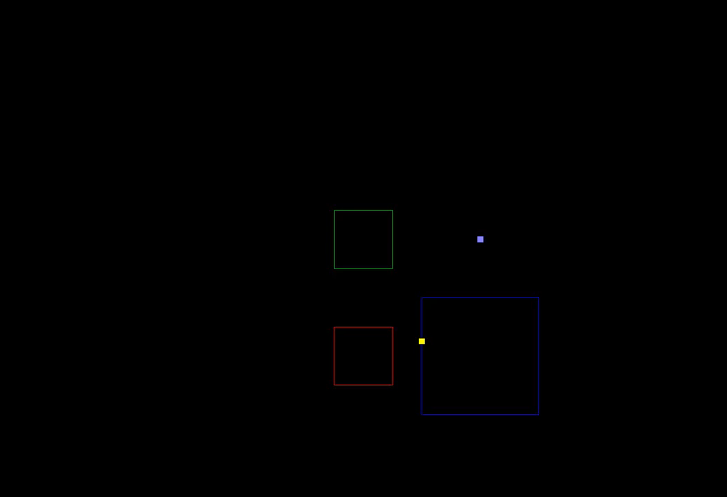
An Intuitive Demo
Minkowski algebra can be applied to polygons in order to determine possible intersections
Minkowski sum can be calculated for arbitrary shapes, at varying cost of time
https://www.youtube.com/watch?v=lDkYE9vvrTY

Slide 6
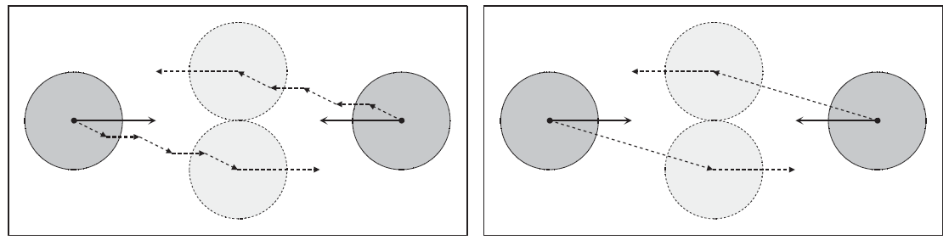
Limitations of VO
Each agent assuming other agents is unresponsive.
Will cause zig-zag path (oscillation)

Slide 7
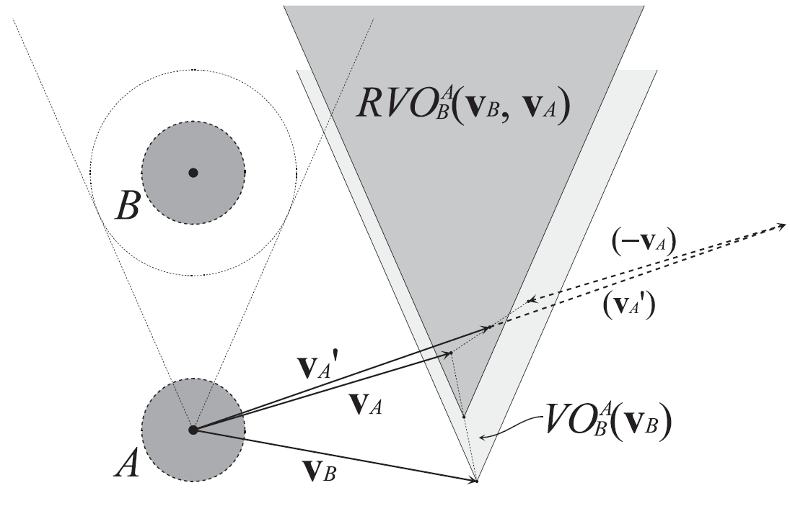
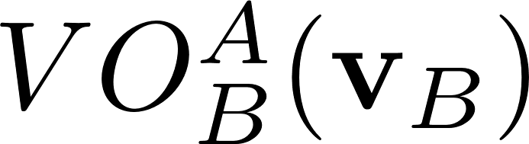
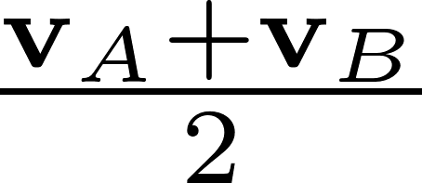
Reciprocal Velocity Obstacles (RVO)
Assuming other agent is mutually cooperating.
Instead of choosing a new velocity for each agent that is outside the other agent’s velocity obstacle, just choose the average of its current velocity and a velocity that lies outside the other agent’s velocity obstacle.
It can geometrically be interpreted as the velocity obstacle that is translated such that its apex lies at
Formally:
Van den Berg, J., Lin, M., & Manocha, D. (2008, May). Reciprocal velocity obstacles for real-time multi-agent navigation. In Robotics and Automation, 2008. ICRA 2008. IEEE International Conference on (pp. 1928-1935). IEEE.

Slide 8
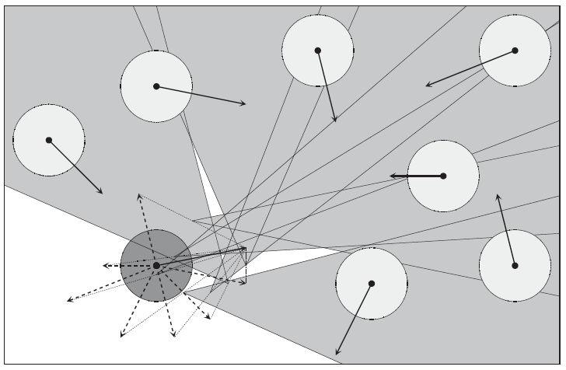
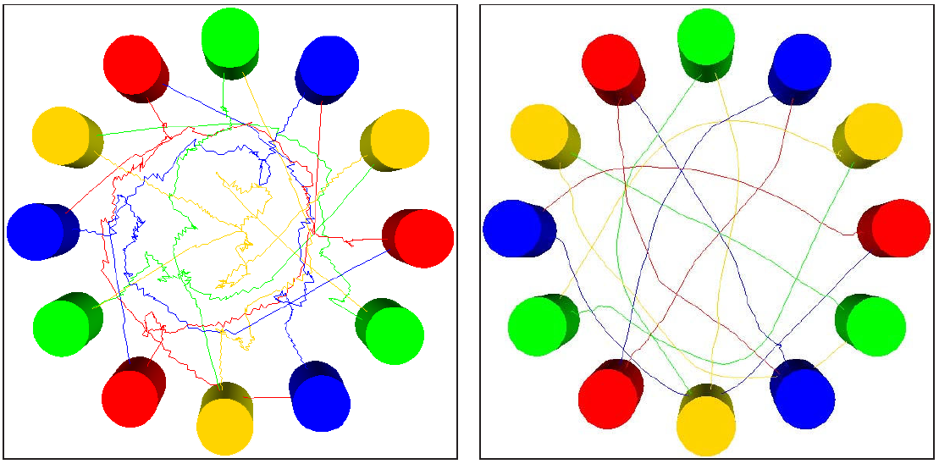
Reciprocal Velocity Obstacles (RVO)
For multiple agents, each chooses a velocity that’s outside of the union of all RVOs introduced by others.
Path comparison (left: VO; right: RVO)

Slide 9
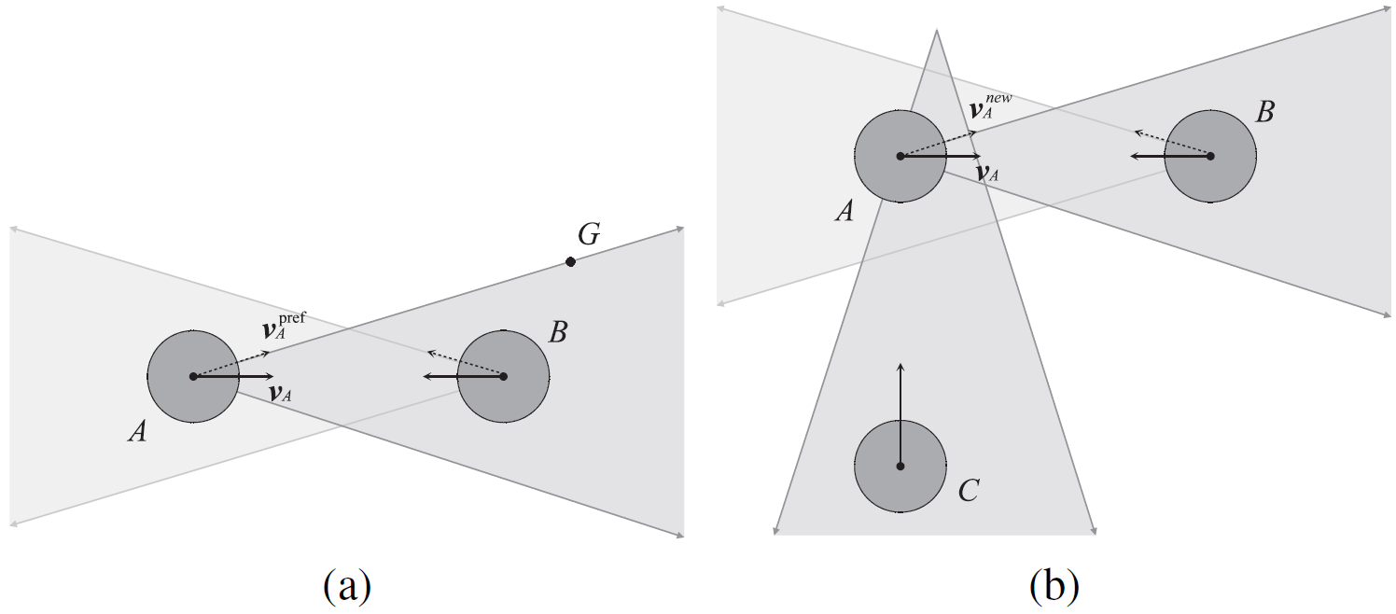
Limitations of RVO
By property of RVO, if each robot chooses the new velocity closest to the current velocity of the robot, then the robots will automatically pass each other on the same side
There are situations that robots may not necessarily choose the same side to pass, which may result in oscillations known as “reciprocal dances”.

Slide 10
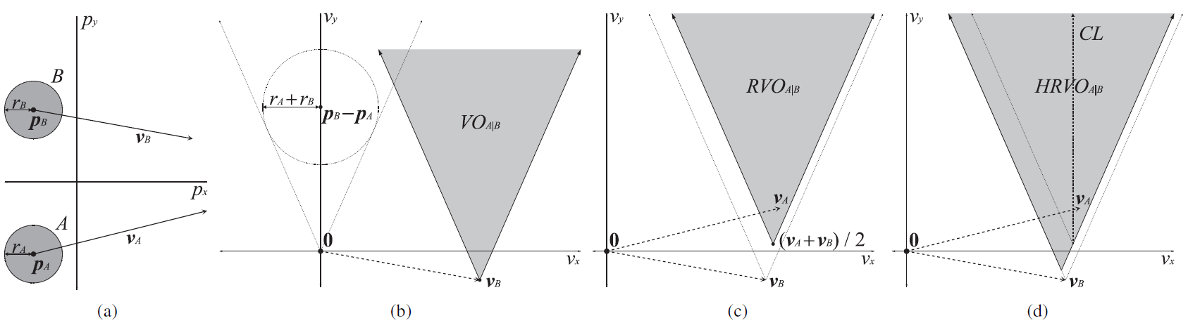
Hybrid Reciprocal Velocity Obstacle (HRVO)
“Reciprocal dances” happens because one of the agent fails to share the responsibility implied by RVO.
HRVO has the original VO on the “wrong side to pass” as a penalty.
This greatly reduces the possibility of oscillations (at least no deadlock).
Snape, J., Van den Berg, J., Guy, S. J., & Manocha, D. (2011). The hybrid reciprocal velocity obstacle. IEEE Transactions on Robotics, 27(4), 696-706.

Slide 11
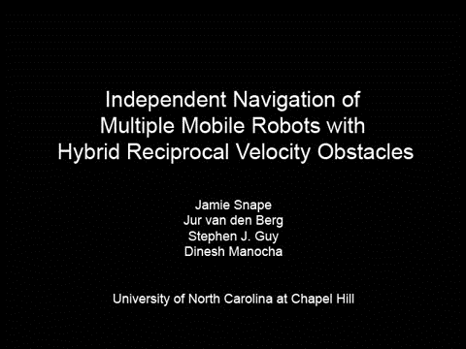
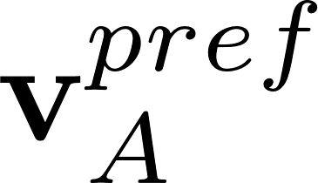
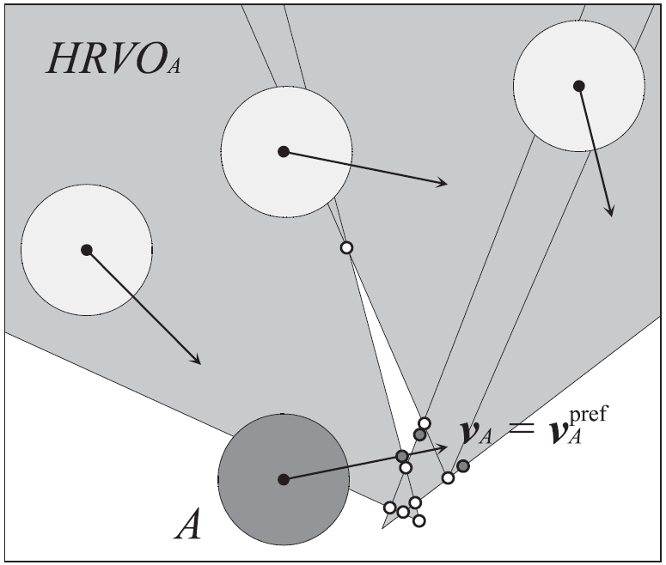
Navigating Multiple Mobile Robots
Represent the combined hybrid reciprocal velocity obstacle as a union of line segments.
Find intersections of all these segments.
Also project onto each segment.
The velocity that is closest to must be in either of these two sets (ClearPath algorithm).

Slide 12
Limitations of (H)RVO
RVO only guarantees collision-avoidance under specific conditions, and does not provide a sufficient condition for collision-avoidance in general.
RVO searches via sampling, might miss the optimal solution.
If velocity of B is in set V_{B}
  permitted velocities PV_{A|B}(V_{B}) for A are outside VO_{A|B} ⊕ V_{B}

Slide 13
Reciprocally Permitted Velocities
Set V_{A} of velocities for A and Set V_{B} of velocities for B are reciprocally permitted if
  V_{A} ⊆ PV_{A|B}(V_{B}) and V_{B} ⊆ PV_{B|A}(V_{A})
Set V_{A} of velocities for A and Set V_{B} of velocities for B are reciprocally maximal if
  V_{A} = PV_{A|B}(V_{B}) and V_{B} = PV_{B|A}(V_{A})

Slide 14
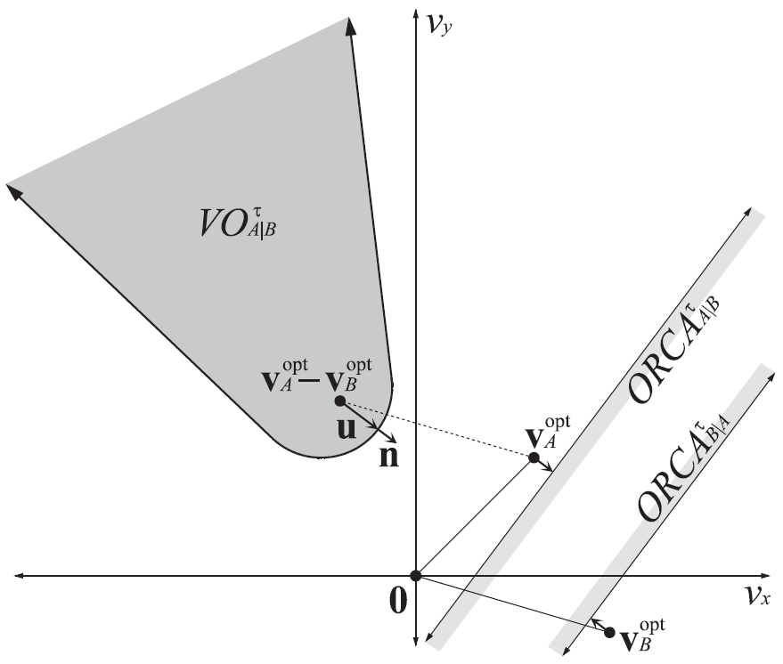
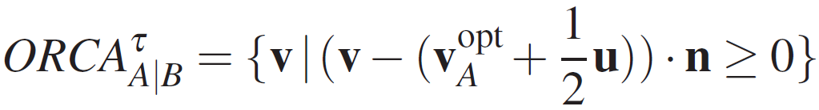
Optimal Reciprocal Collision Avoidance (ORCA)
Nominally, the optimization velocities are equal to the current velocities, such that the agents have to deviate as little as possible from their current trajectories to avoid collisions
u – Vector which escapes VO^{τ}_{A|B}
  Each agent is responsible for ½u
ORCA^{τ}_{A|B}
  The set of velocities allowed to A
  Sufficient condition for collision avoidance if B chooses from ORCA^{τ}_{A|B}
  Formally:
Van Den Berg, J., Guy, S., Lin, M., & Manocha, D. (2011). Reciprocal n-body collision avoidance. Robotics research, 3-19.

Slide 15
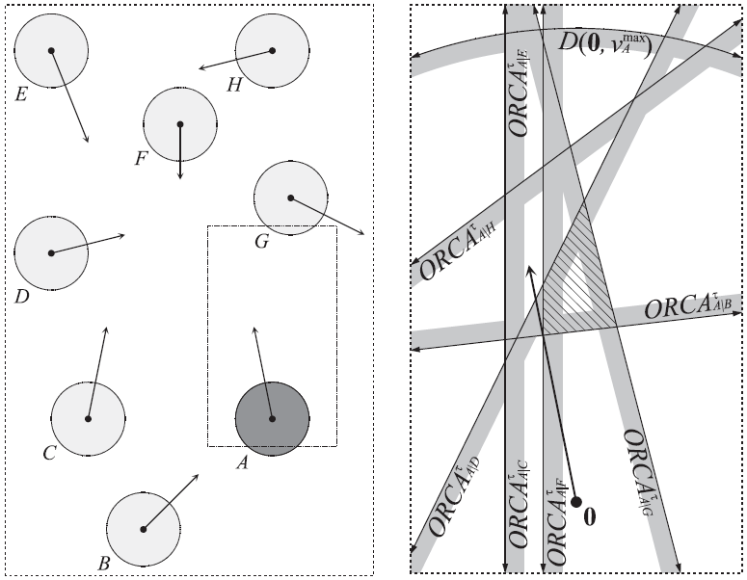
n-Body Collision Avoidance
Choose a velocity inside ALL pair-wise ORCAs.
Efficient O(n) implementation w/ Linear Programming.
In each time step for each agent:
  Find neighbors using Kd tree
  Calculate Minkowski sums
  Find ORCA constraint line
  Solve for new speed by linear programming

Slide 16
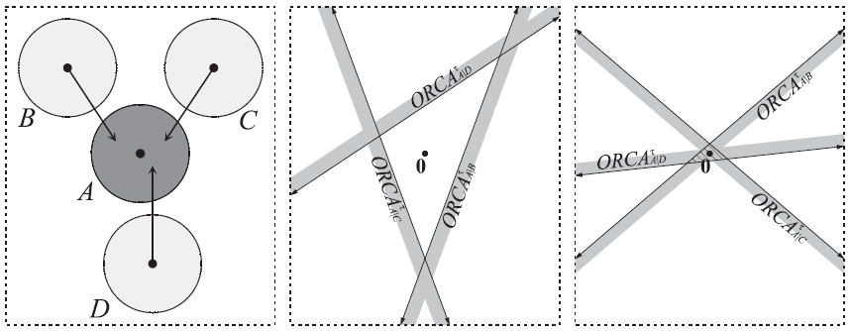
Densely Packed Conditions
If V^{opt} != 0, solution may not exist
  Find the “least bad” velocity
  Efficient implementation possible with 3D linear programming that still runs in O(n) expected time
Note that in these dense cases, the new velocity selected for the agent does not depend on the agent’s preferred velocity. This means that the agent ‘goes with the flow’.

Slide 17
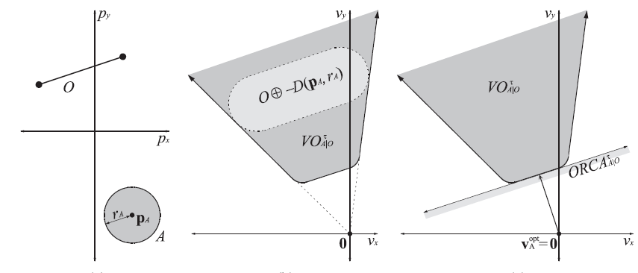
Static Obstacles
ORCAs can also be created for obstacles in the environment
ORCA is half-plane tangent to VO ^{τ} _{A|O}

Slide 18
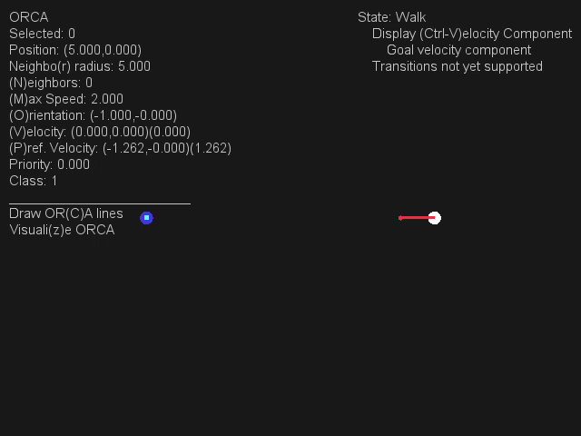



Fail Cases
ORCA can fail when there is perfect symmetry between agents.

Slide 19
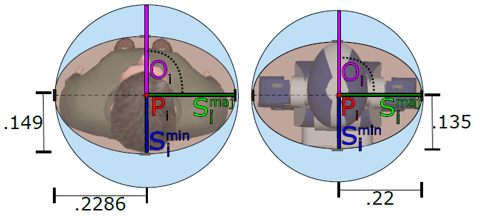
Limitations of ORCA
A disc overestimates the actual profile of the robots or humans (overly conservative).
2D ellipses provide a better approximation of human body in terms of shape and movement.

Slide 20
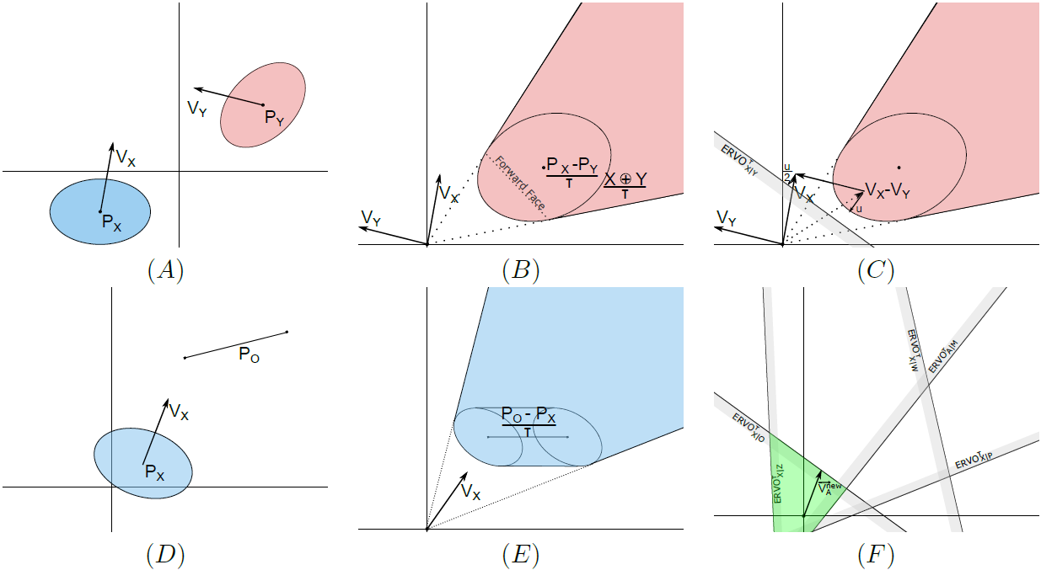
Reciprocal Collision Avoidance with Elliptical Agents (EORCA)
(A) Two agents are moving toward one another in space.
(B) The velocity obstacle for X induced by Y takes the shape of a truncated cone. The apex of the cone is located at the origin in velocity space.
Best, A., Narang, S., & Manocha, D. (2016, May). Real-time reciprocal collision avoidance with elliptical agents. In Robotics and Automation (ICRA), 2016 IEEE International Conference on(pp. 298-305). IEEE.

Slide 21
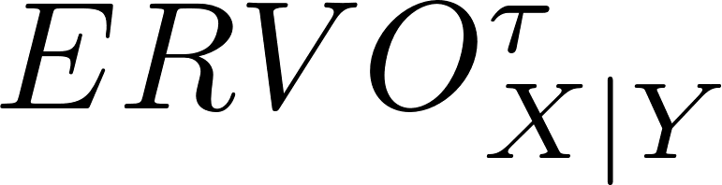
Reciprocal Collision Avoidance with Elliptical Agents (EORCA)
(C) The set of permitted velocities for agent X w.r.t. Y represented by the half-plan constraint .
(D)(E) An agent moves toward a line segment obstacle.

Slide 22
Reciprocal Collision Avoidance with Elliptical Agents (EORCA)
(F) Determine a feasible velocity inside the union of all the ERVO sets. A new velocity is chosen from the region of feasible velocities.

Slide 23
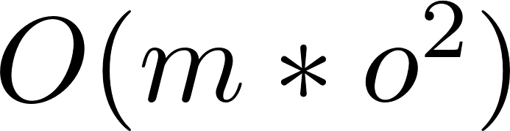
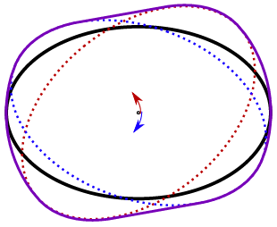
Precomputation
Computing Minkowski sums of ellipses is considerably more expensive than using disks. Precomputing pair-wise Minkowski sums between ellipses with different orientations to maintain real-time performance.
The precomputation time is on the order of minutes and spatial complexity is where m is the number of samples on the ellipse and o is the number of orientation intervals (120MB for o = 72; m = 100).

Slide 24
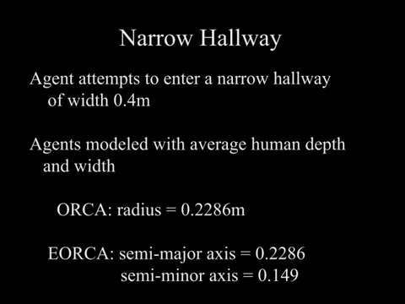
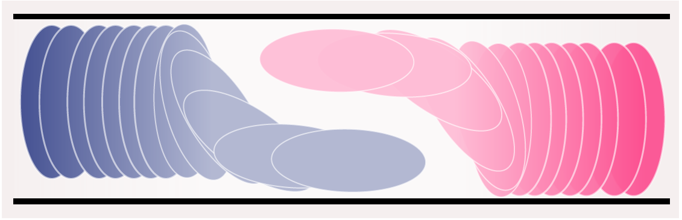
Results
ERVO-C: In the simplest case, the agents maintain their orientation between successive simulation time-steps.
In some cases, the agent must change its orientation in order to find a collision-free velocity.

Slide 25
Limitations of EROCA
The orientation update is decoupled from the velocity computation, instead of being updated simultaneously with velocity.
ERVO algorithm without precomputation is expensive compared to disc-based methods and the choice of an appropriate orientation interval is not easy.
ERVO assumes perfect sensing and does not account for hardware related errors.

Slide 26
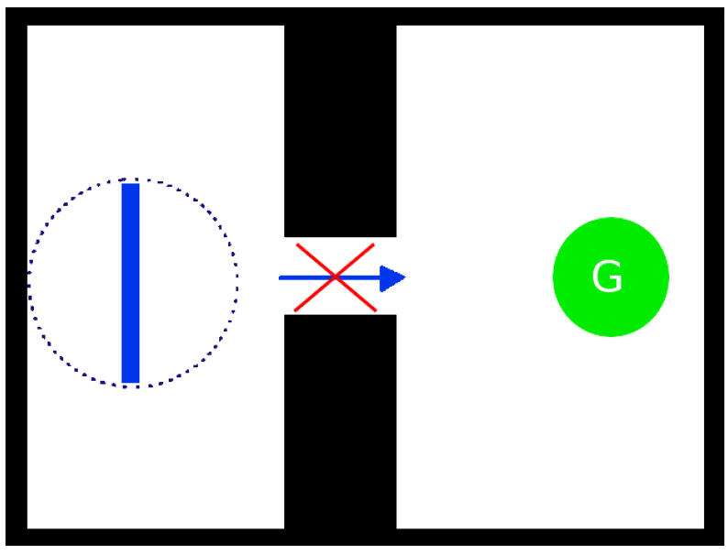
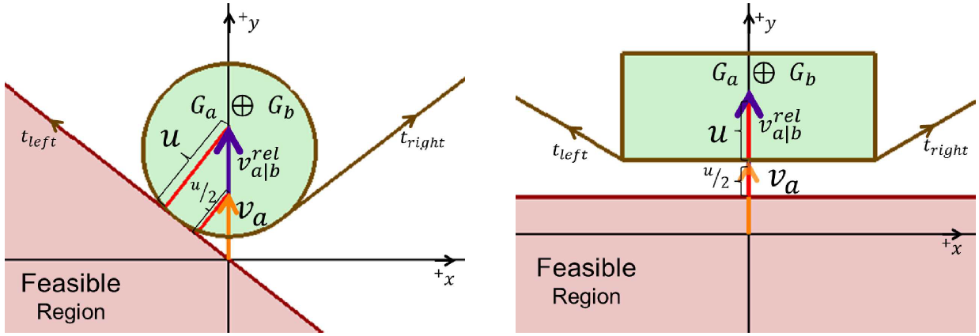
Reciprocally-Rotating Velocity Obstacles (RRVO)
RRVO represents agents as convex rotating polygons.
Agents avoid colliding with each other while rotating by assuming their neighbors may rotate as much as themselves.
When agents become near, so do the tangent points on the Minkowski sum between their geometries. RRVO is able to resolve some cases ORCA cannot solve.
Giese, A., Latypov, D., & Amato, N. M. (2014, May). Reciprocally-rotating velocity obstacles. In Robotics and Automation (ICRA), 2014 IEEE International Conference on (pp. 3234-3241). IEEE.
Notes:
A long skinny agent (blue rectangle) cannot reach its goal, G (green), if represented as its bounding circle (blue dotted circle) or if only translational movement is permitted
A linear constraint (pink region) on va is derived from the velocity obstacle. When agents become near, so do the tangent points they compute on the dilated disc representing the Minkowski sum between their geometries. That is, vrel a|b almost always eventually projects onto a tangent line, allowing agents to move around each other

Slide 27
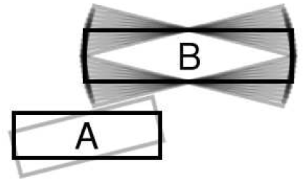
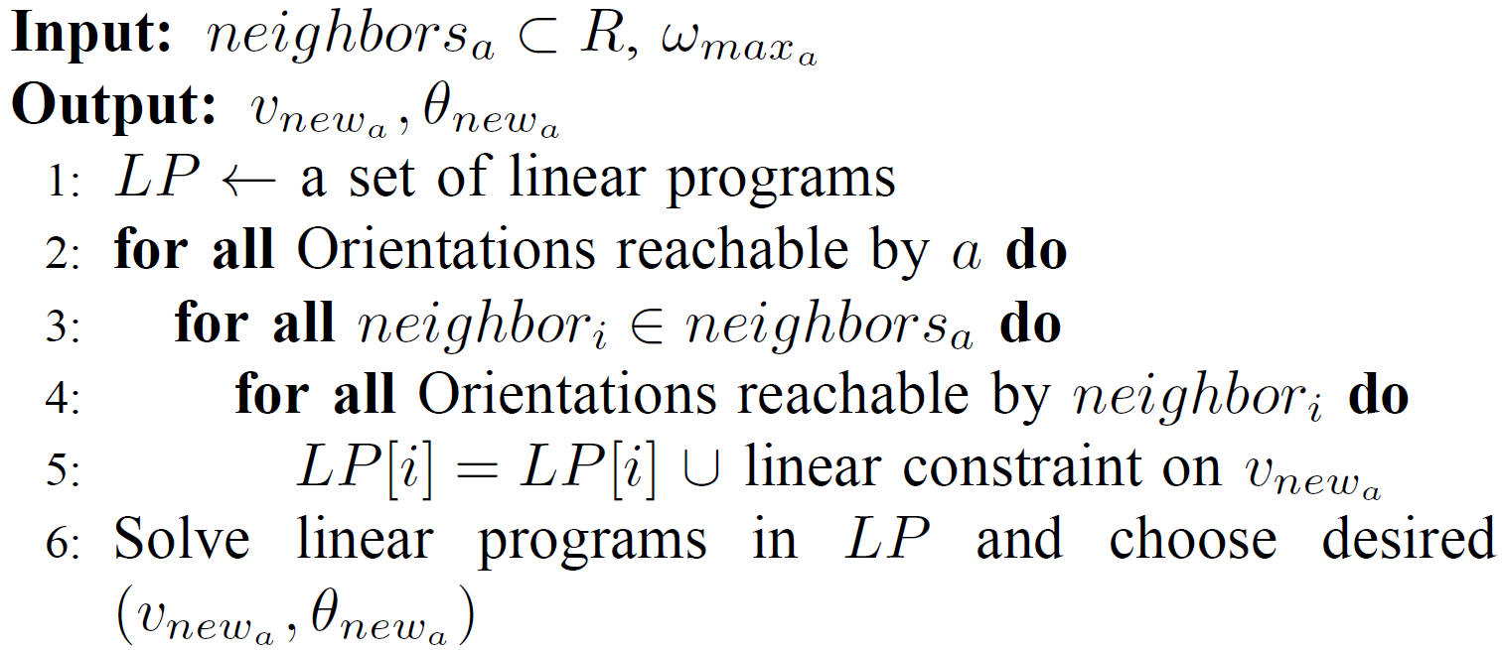
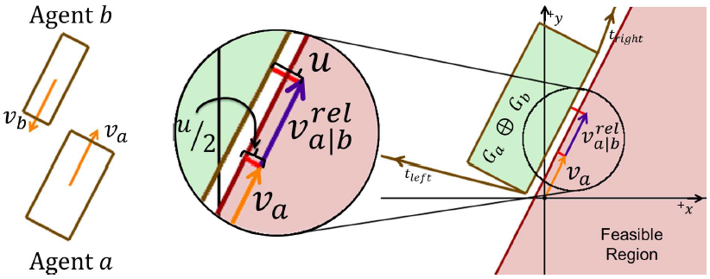
Reciprocally-Rotating Velocity Obstacles (RRVO)
Velocity and orientation are optimized simultaneously with RRVO
Algorithm summary
  Agents assume that the reachable change in their own orientation is the same reachable change by any neighbor.
  If a rotation causes collision with any neighbors’ set of potential orientations, no more linear programs are created.
  All linear programs are solved and some function is applied on the resulting choices to choose an optimal one.

Slide 28
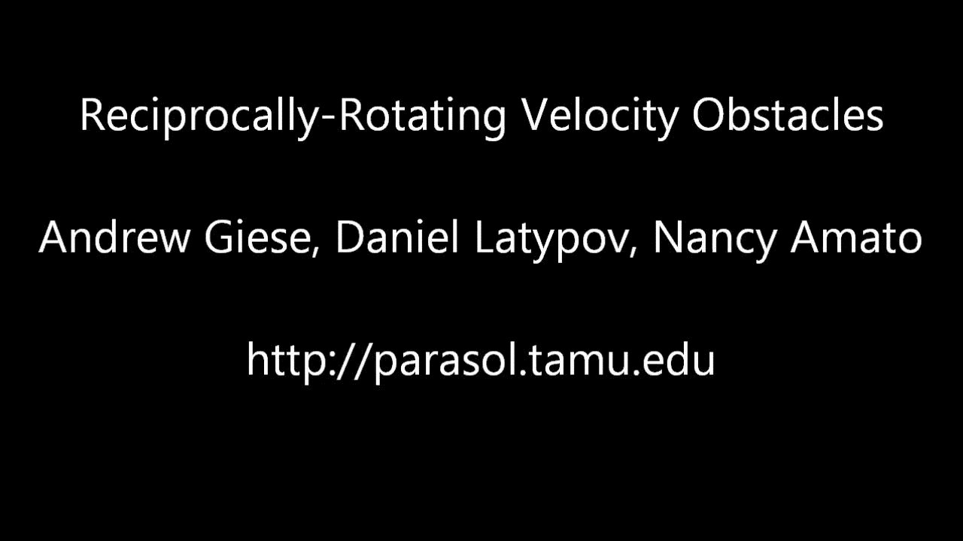
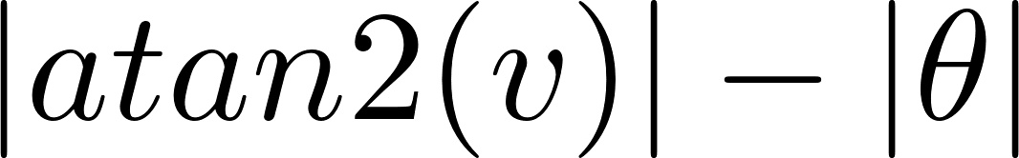
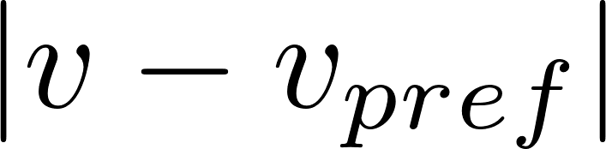
Reciprocally-Rotating Velocity Obstacles (RRVO)
Further optimization
  Linear program feasibility (favor linear programs that don’t relax constraints)
  Minimization of (favor those that allow agents to face their velocity vectors)
  Minimization of (favor those that allow agents to follow their preferred velocities)
https://parasol.tamu.edu/dsmft/research/flock/rrvo.php

Slide 29
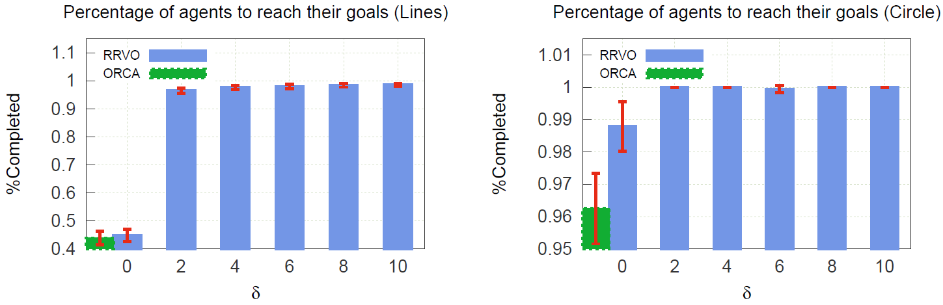
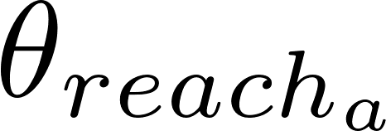

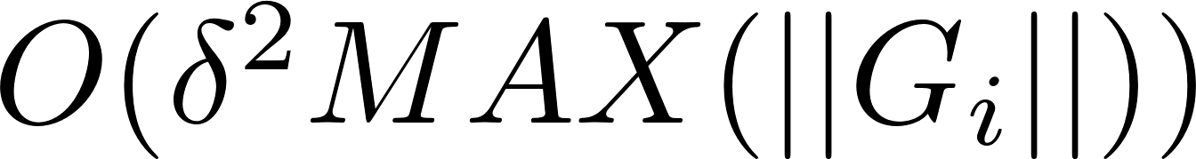
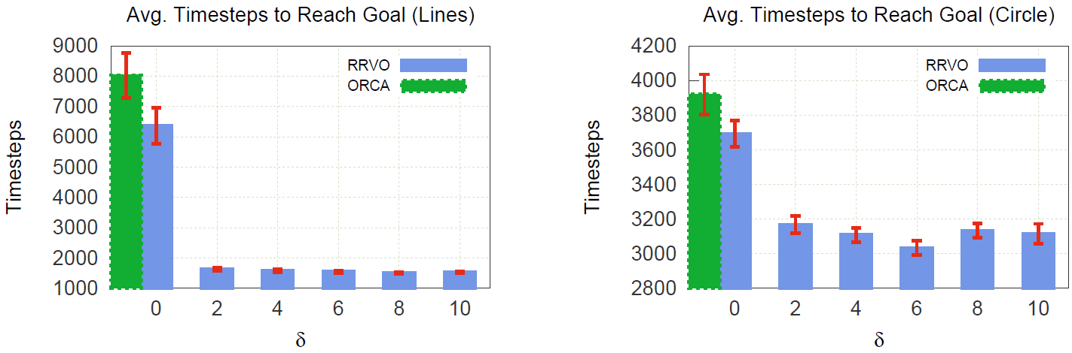
Performance of RRVO
RRVO approximates the bounds on by discretizing the set of rotations by the constant .
Theoretical complexity is
RRVO can also be run at interactive rate.
Even a little bit of rotation results in much less deadlock.
Low amounts of collision and more direct paths towards goals than ORCA

Slide 30
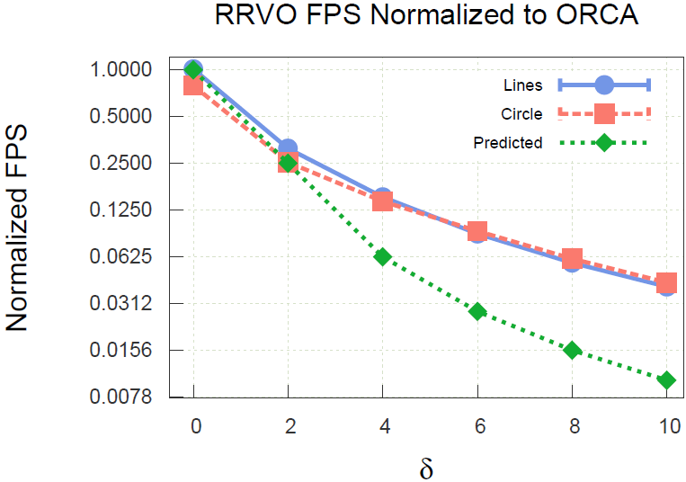
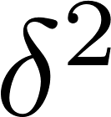
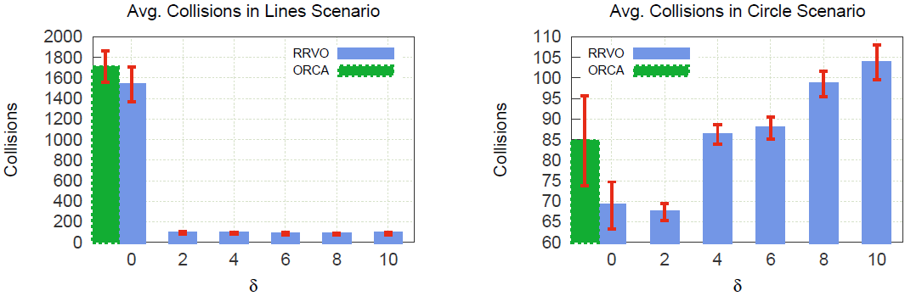
Limitations of RRVO
RRVO’s performance worsens relative to ORCA on the order of .
On some scenario RRVO results in more collisions than ORCA.

Slide 31
Thank You!
Questions or comments?

